Slide 1

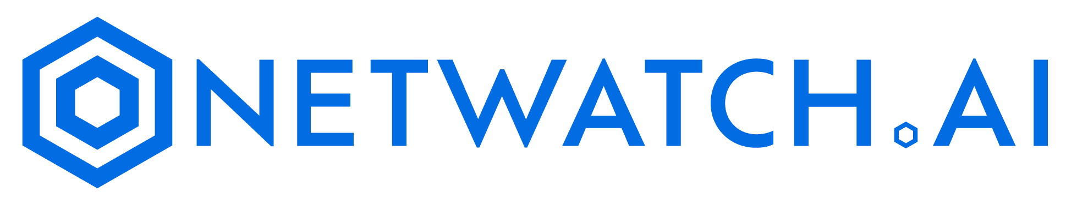
Seamless Monitoring With the Power of Ai

Slide 2


What is NETWATCH.AI
NetWatch.Ai is the world’s most scalable monitoring solution suite for all servers, network devices, and OT endpoints with flexible artificial intelligent insights.
NetWatch.Ai monitors the health and performance of servers and when issues arise, alerts are executed via NetWatch.ai dashboard. Our AI interface allows for help desk empowerment and increases speed to diagnose complex networks to prevent server outages.
Using a patented technology NetWatch.Ai monitors devices with or without installing agents, providing the power and flexibility to define the monitoring architecture to match customers’ exact needs.

Slide 3


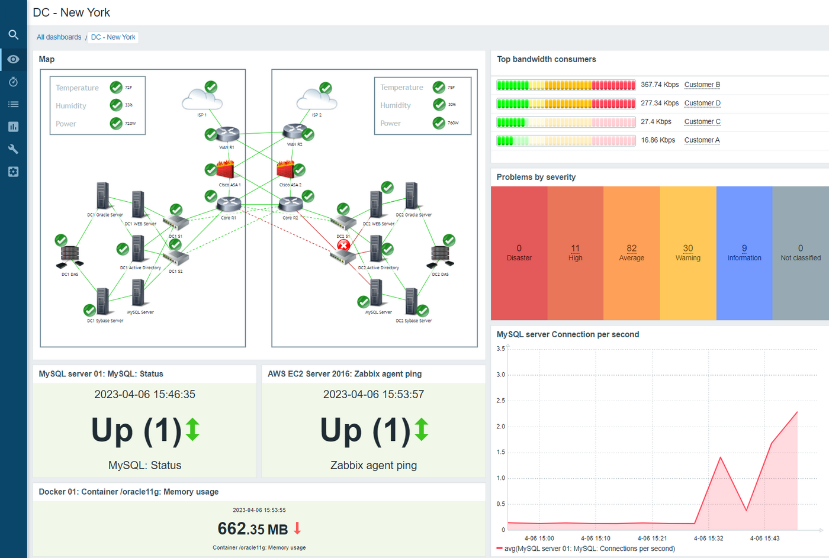
NetWatch OPS
Comprehensive Coverage
Monitor servers, networks, and applications from a single interface, ensuring that no component
goes unnoticed.
Instantaneous Performance Metrics
Track CPU usage, memory consumption, disk I/O, network latency, and application response times in real-time.
Dynamic Thresholds
Set customizable thresholds for alerts based on historical performance data and predictive analytics.
Multi-Channel Alerts
Receive alerts via email, SMS, or through integrations with collaboration tools like Slack or Microsoft Teams.
Severity-Based Notifications
Categorize alerts by severity (Critical, Warning, Information) to prioritize and response and efforts effectively.
Incident Escalation Policies
Implement automatic escalation procedures to ensure critical issues receive timely attention from relevant stakeholders.
User-Friendly Interface
Customize your dashboards to showcase the most relevant data for your organization, offering a visual, intuitive experience.
Drag-and-Drop Functionality
Easily add or rearrange widgets to tailor dashboards to specific operational needs.

Slide 4

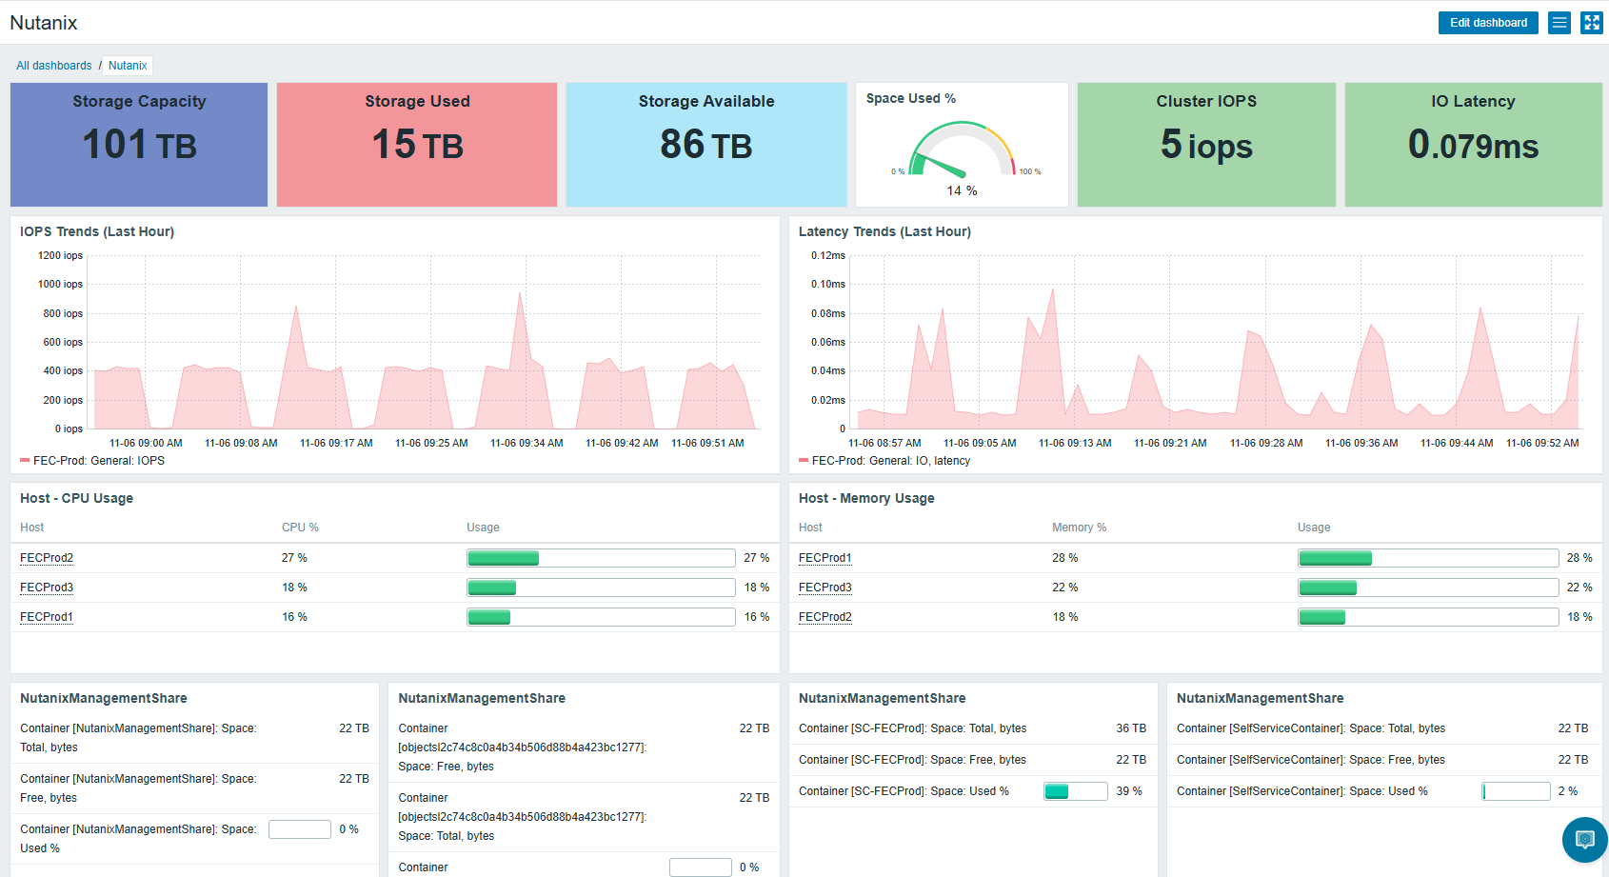
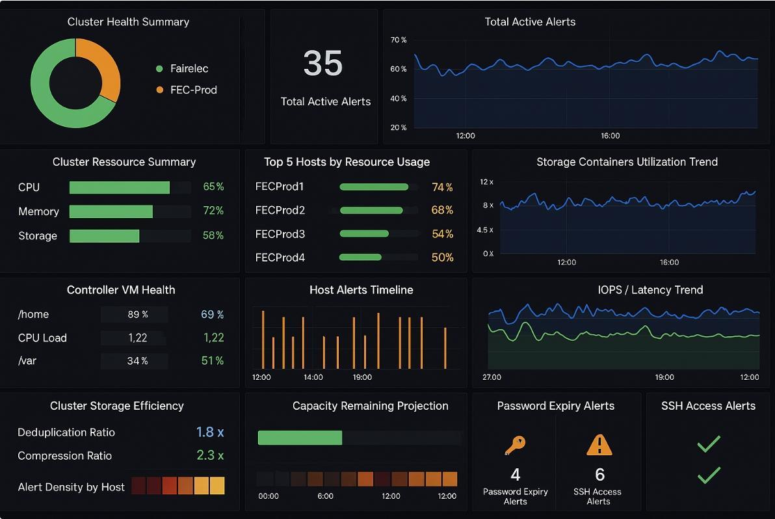
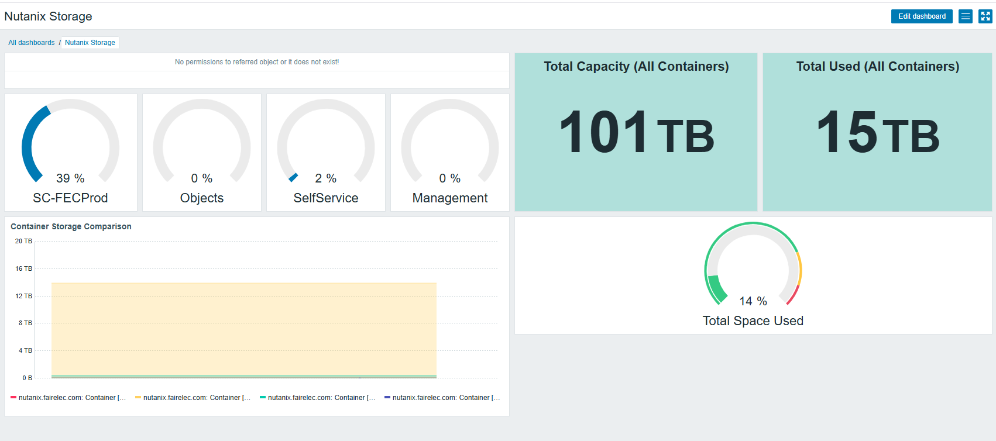
Nutanix
Detailed Management Dashboards
NetWatch OPS allows for the integration of Nutanix API data in management dashboards.
The layout is customized by our team based on your requirements for latency, space utilization and compliance & risk.
Since all data is captured and stored in Netwatch OPS backend, you can build reports for it or simply ask the Ai about utilization or latency or even about password alerts.
NetWatch.Ai makes management of the Nutanix environment simple and efficient.

Slide 5
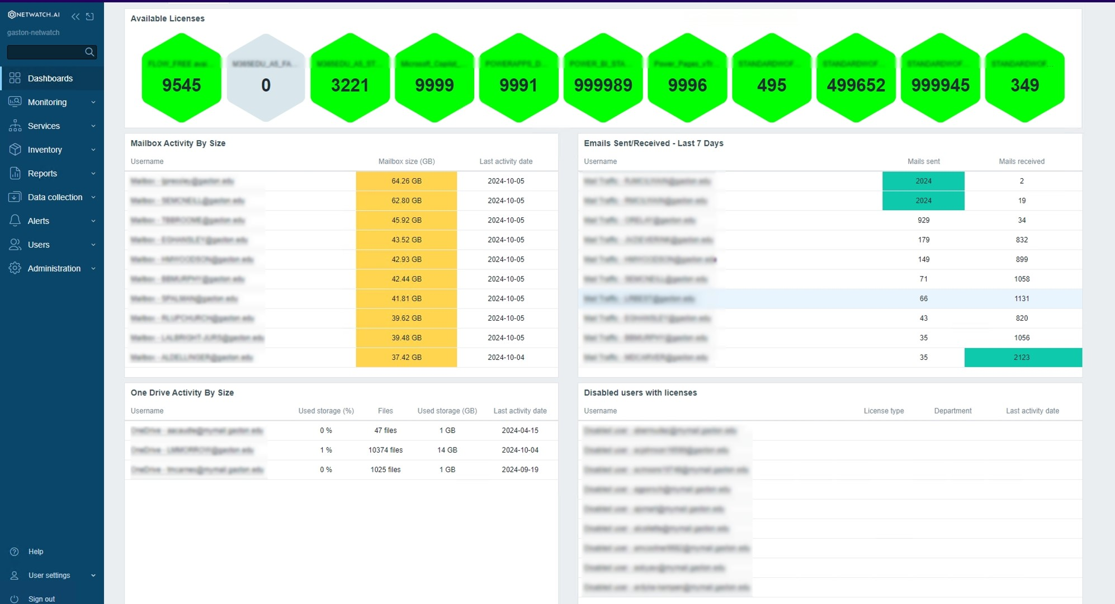
M365
Cloud Key Management Dashboards
NetWatch OPS allows for the optional use of M365 management of keys from a quick dashboard view.
The layout is customized based on your requirements for mailboxes, OneDrive, SharePoint or Teams metrics.
Since all data is captured and stored in Netwatch OPS backend, you can build reports for it or simply ask the Ai what keys aren’t being utilized or have passwords that are about to expire.
NetWatch.Ai makes management of the M365 environment simple and efficient.

Slide 6

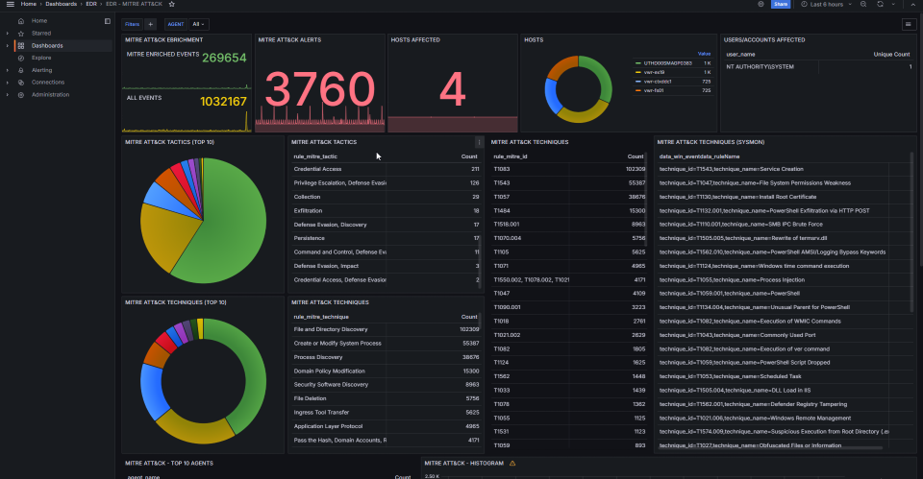

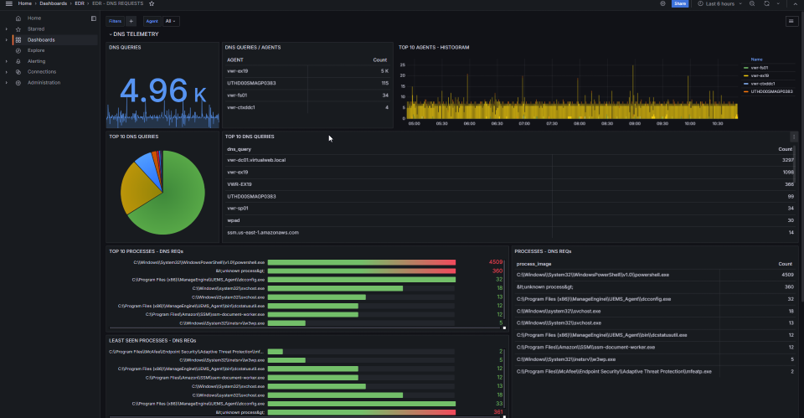
Login
Contact Us
Secure OPS
Next-generation SIEM solution designed to revolutionize your security infrastructure
Cloud & On-Prem together at last
Next-generation SIEM solution designed to revolutionize your security infrastructure. A hybrid SIEM platform that seamlessly integrates cloud & on-premise environments, delivering unified security monitoring and compliance management

Slide 7
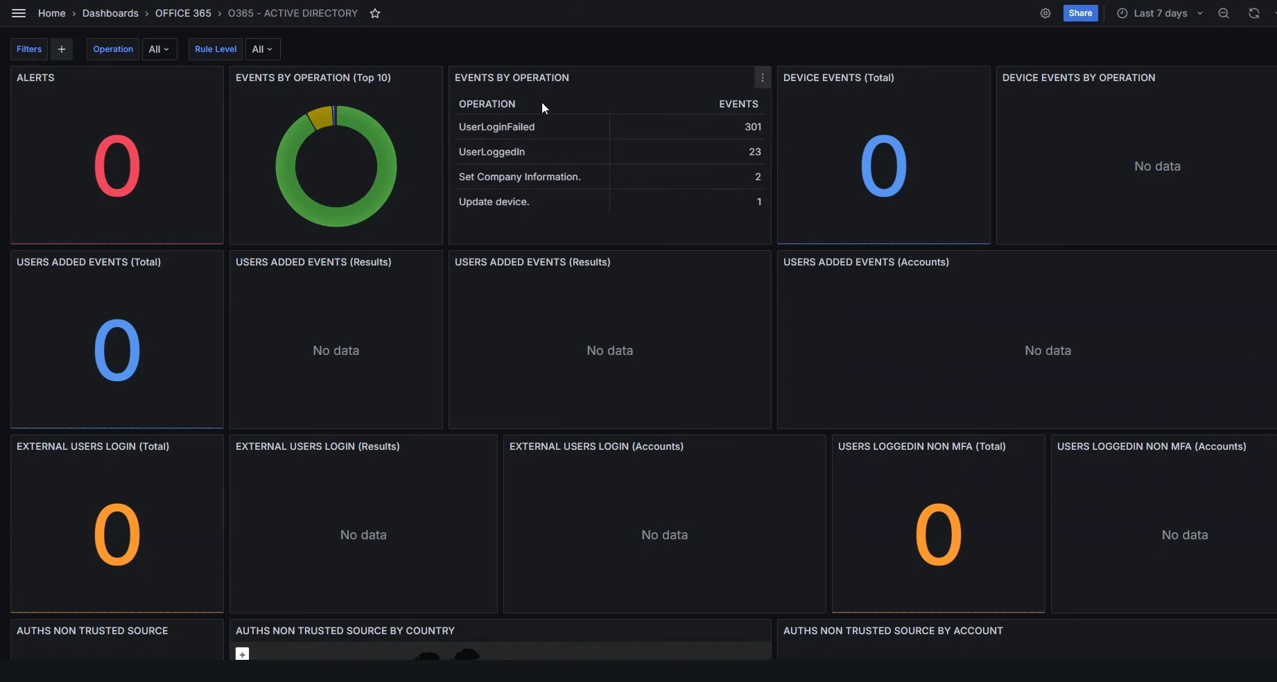

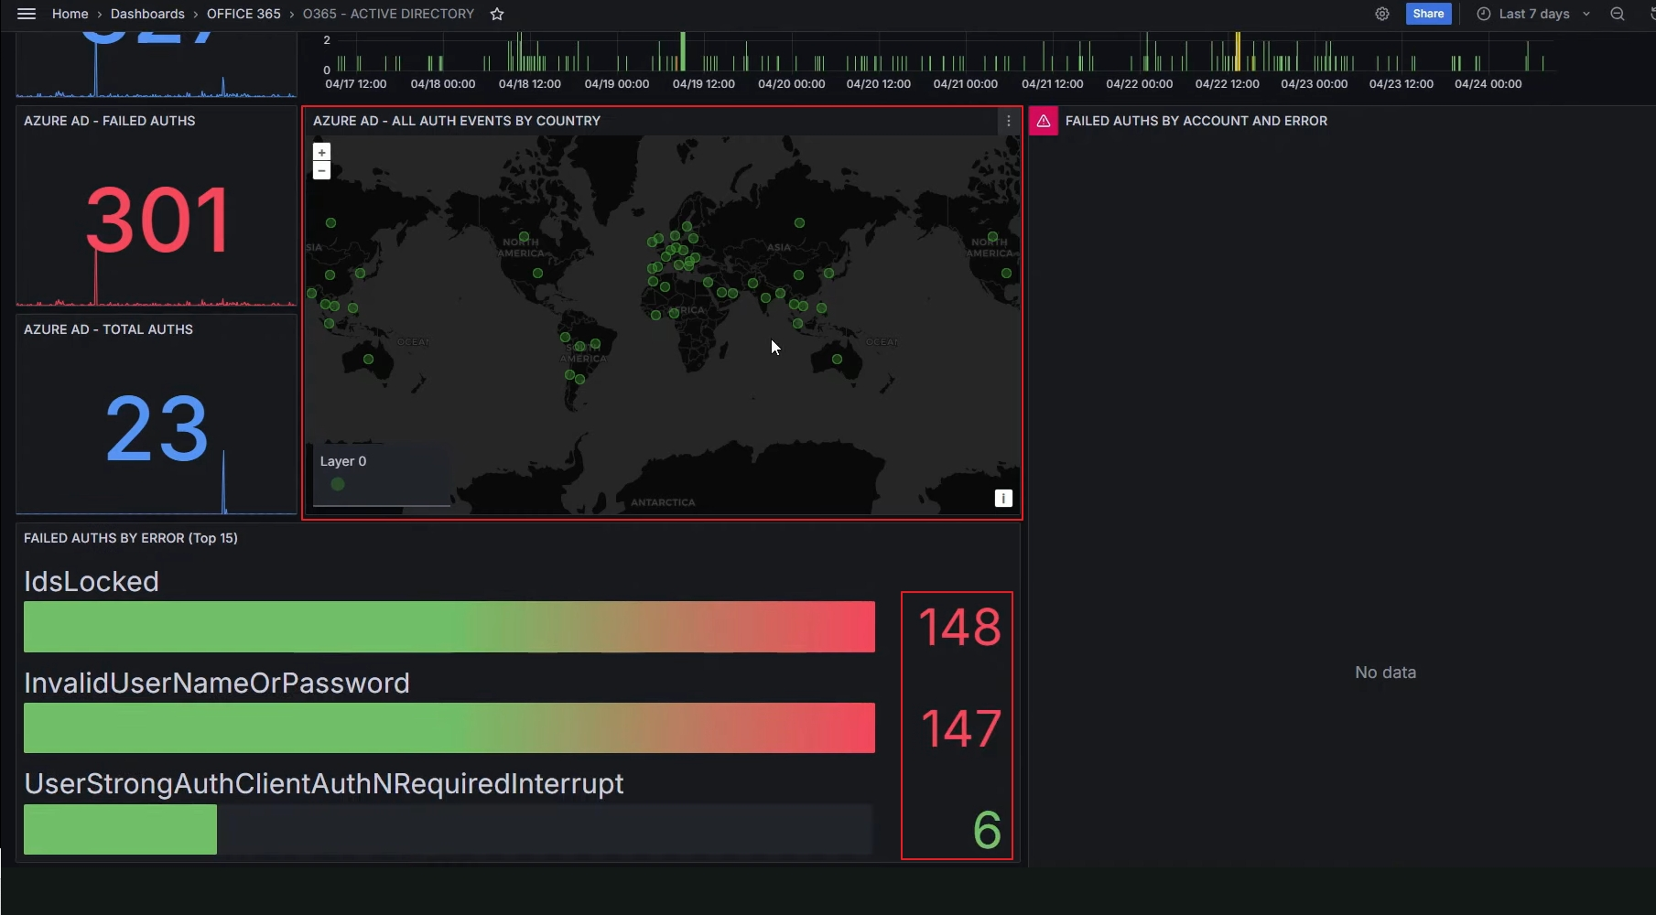
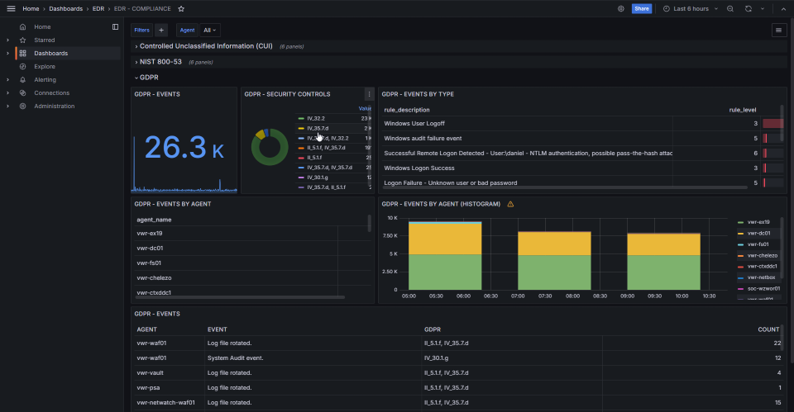
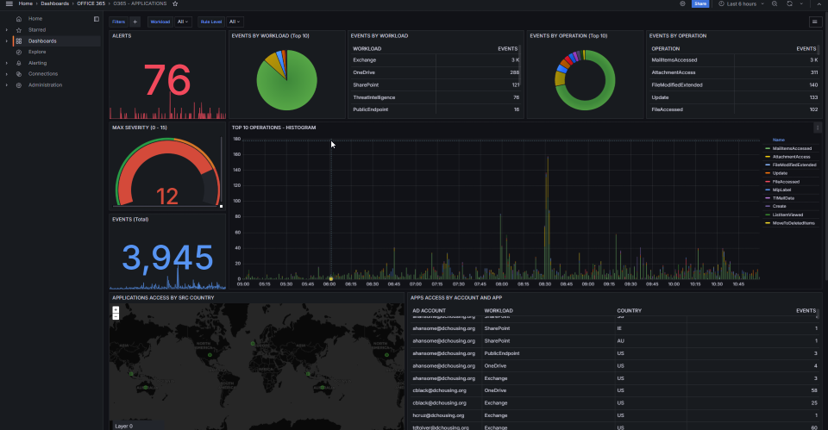
complete SIEM = actionable alerts
Robust support for multiple compliance frameworks, Secure Ops simplifies adherence to industry standards such as GDPR, CIS, NIST, and more. Its advanced CVE update integration ensures your threat intelligence is always current, while built-in MITRE ATT&CK analysis offers in-depth insights into attack patterns and adversary tactics.
As one of the only true hybrid SIEM platforms, Secure Ops seamlessly integrates cloud and on-premise environments, providing comprehensive, unified security monitoring and compliance management.
Empower your security team with real-time alerts, automated threat detection, and streamlined compliance reporting—all within a flexible, scalable platform that adapts to your evolving infrastructure. Secure Ops by Netwatch.ai is your ultimate partner for comprehensive, unified, and future-proof security management toolset.

Slide 8
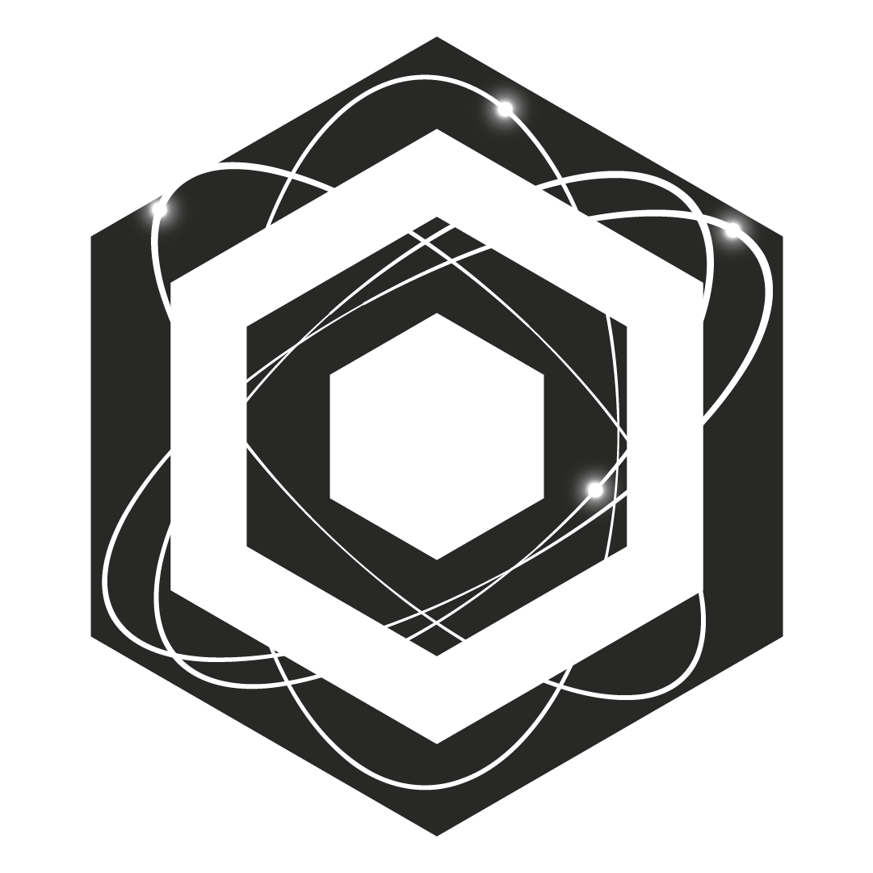


Ai – (QUARK)
Ai platform leveraging machine learning to predict issues, automate solutions, and enhance IT operations for smarter performance management. (Quick Unification and Analysis of Relevant Knowledge)
Product Overview
Meet QUARK—your essential AI for network operations. Quick, adaptable, and always at the core, QUARK unifies your event data and reveals the patterns that matter. With foundational intelligence and unmatched precision,
QUARK is the unseen force driving clarity and confidence in your security operations. This innovative tool streamlines system administration by leveraging machine learning to automate routine tasks, optimize operations, and provide deep insights into your IT environment.
  Agentic & On-prem
  “I’ve noticed a pattern that may impact your security. Here’s what I recommend…”
  “No significant events detected. Your systems are secure.”
  “This correlation suggests a deeper issue. Would you like more details?”
System Admin
CISO
Ai threat & Governance

Slide 9
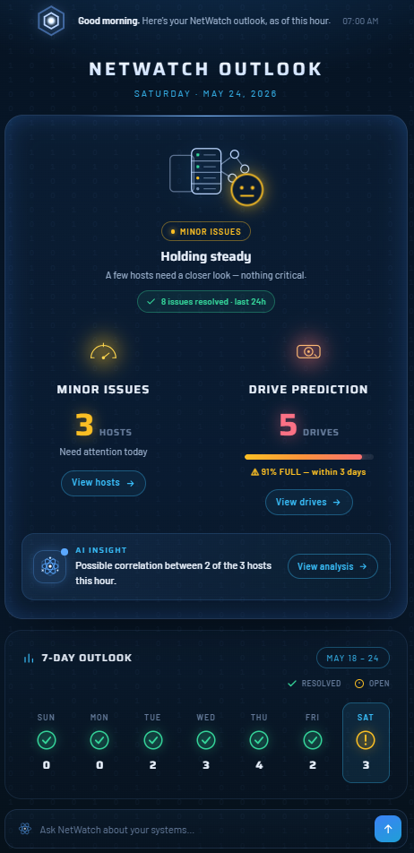
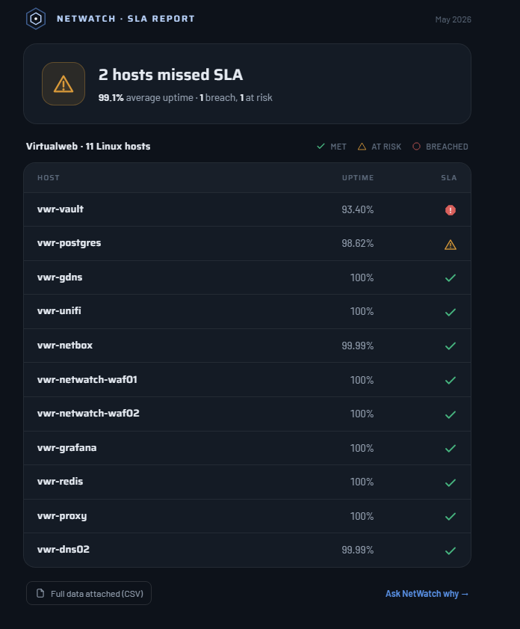
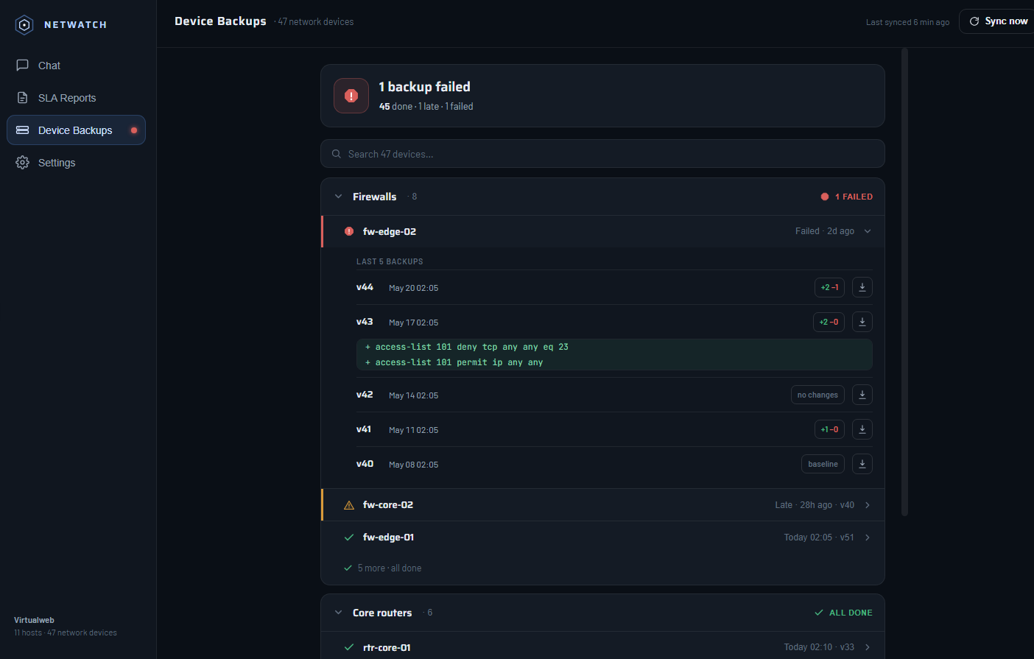
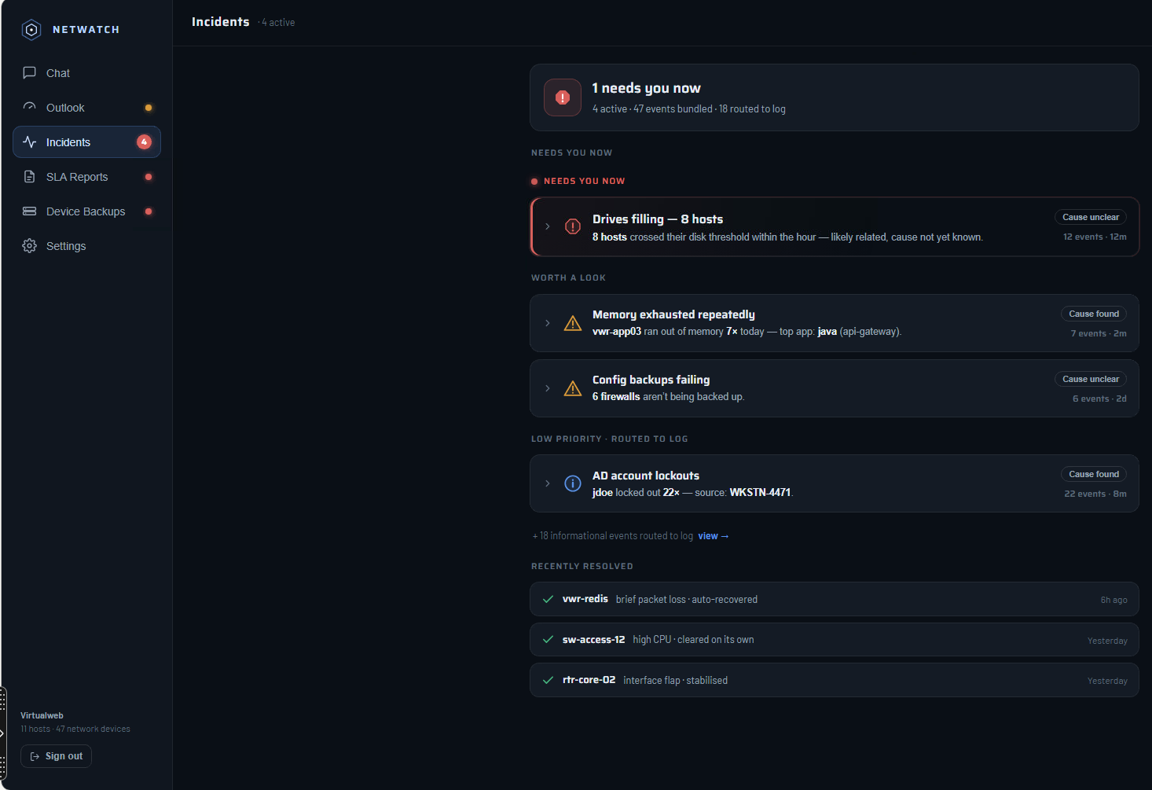
Artificial Intelligent Seamless Monitoring
Gentic Ai bot (QUARK) to help your IT group troubleshoot areas of concern or give a tip to point the helpdesk in the right direction. It understands the context of your environment, so you can ask predictive questions about hardware and server issues pertaining to your specific needs..
QUARK has SLA reports direct from the prompt & backup network devices + show config changes made to the device.

Slide 10
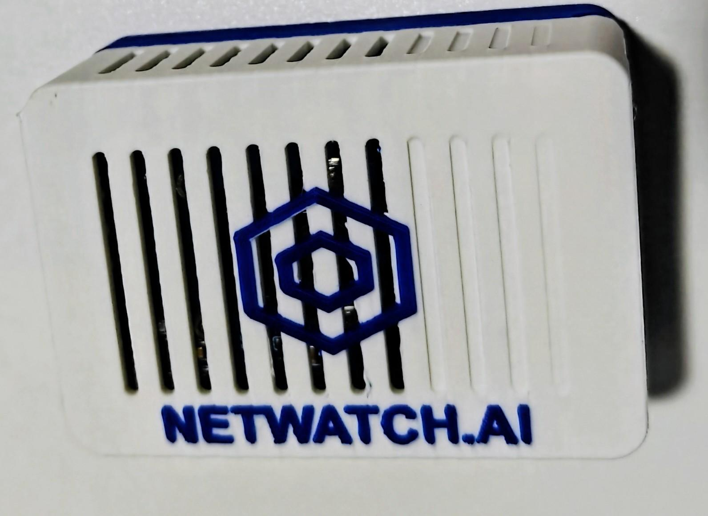
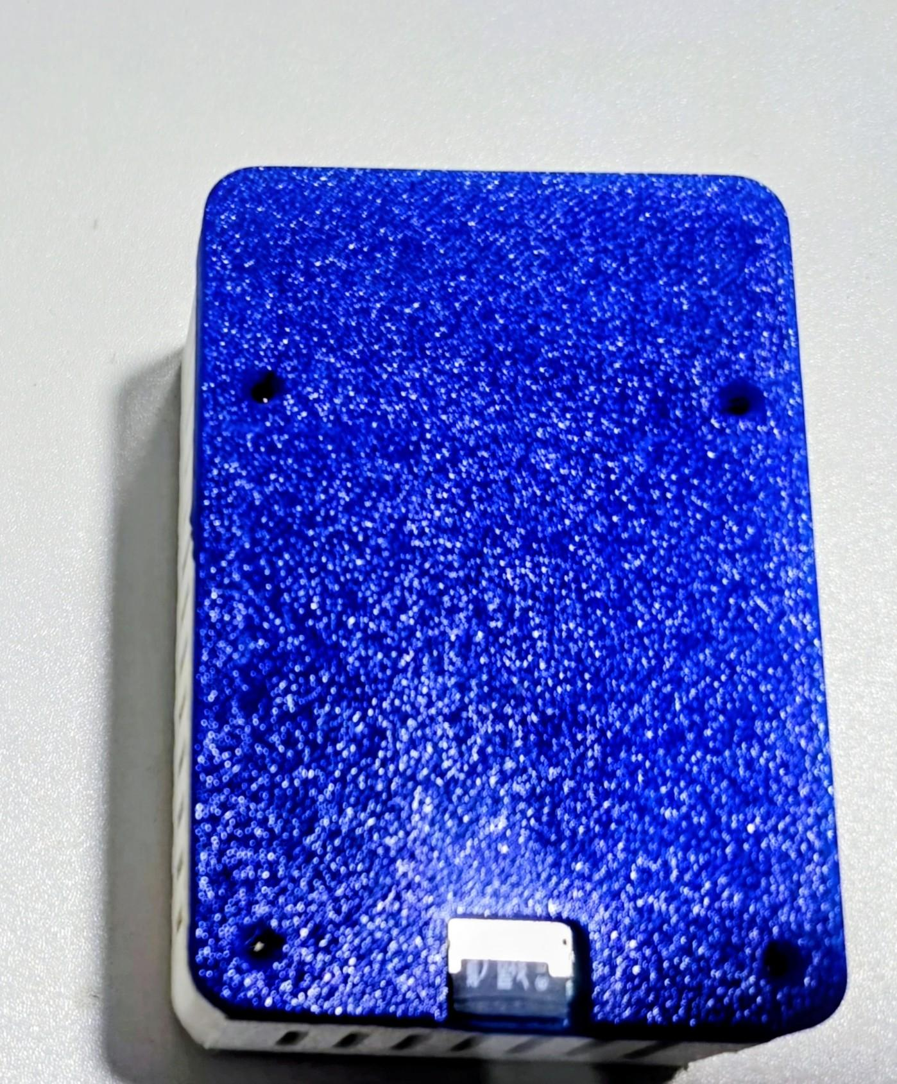
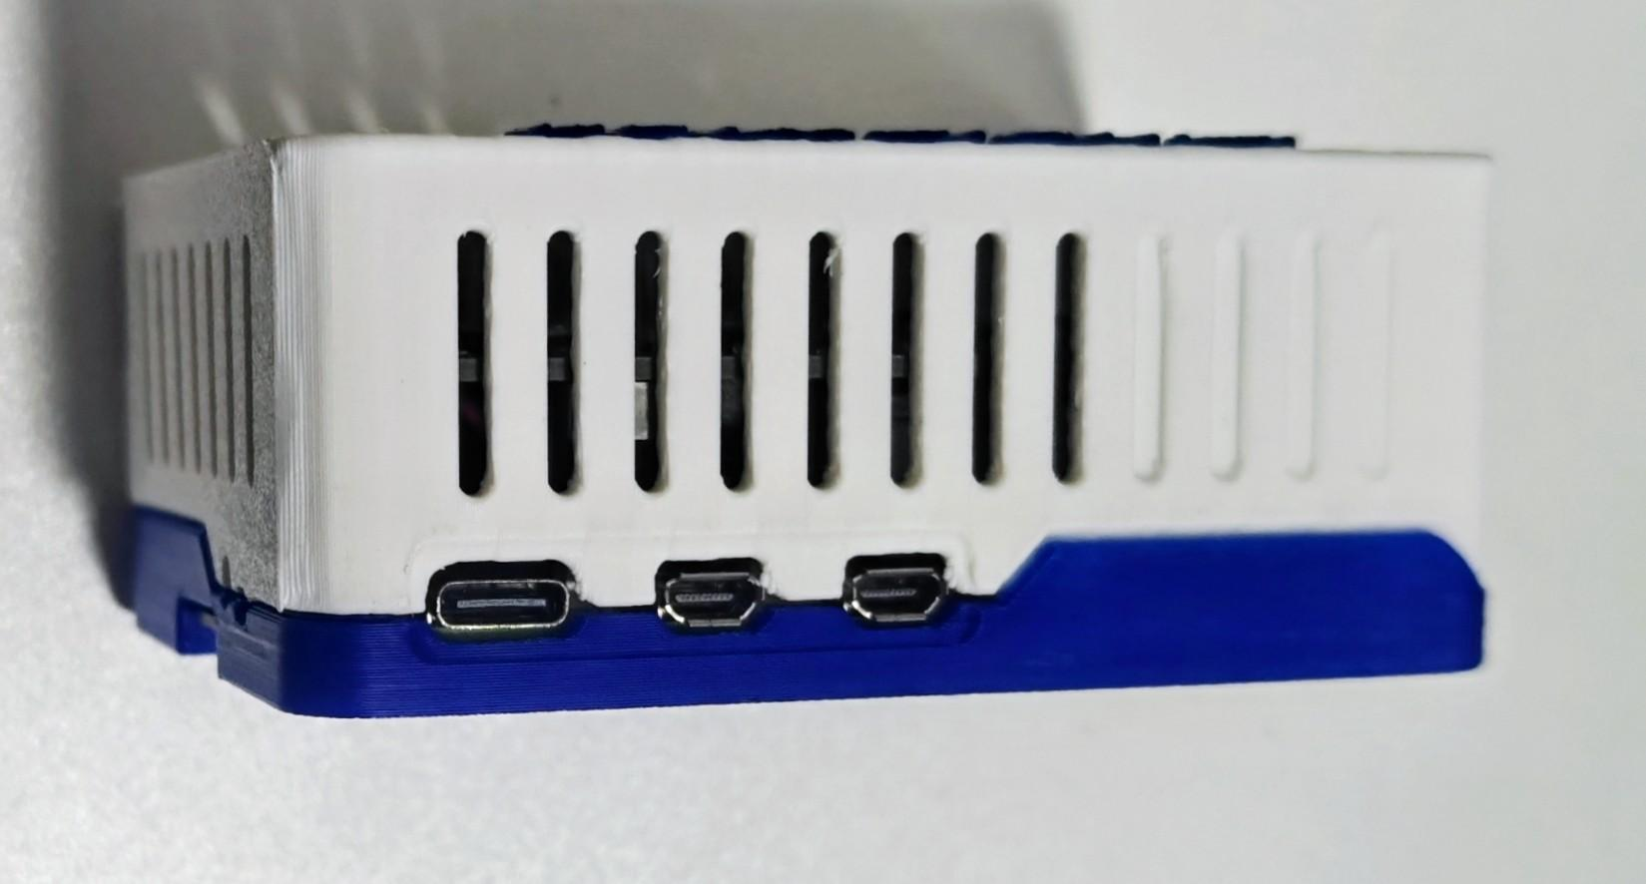
Deployment Options
Ai driven monitoring platform with flexibility to deploy as an virtual Image, SaaS, Hybrid or with our MicroNode™ depending on your own network layout and needs.
Deployment Overview
Virtual Image -Ubuntu
SaaS – our private cloud
Hybrid deployment
On-prem
MicroNode™
BYOAi

Slide 11
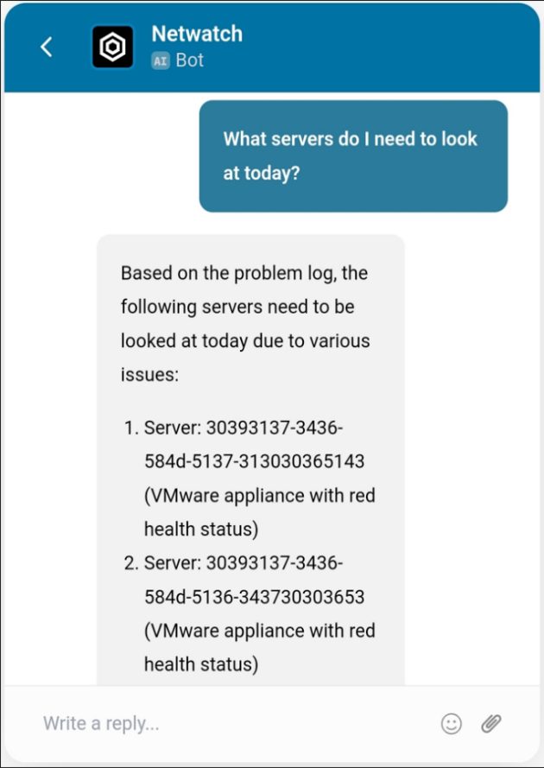
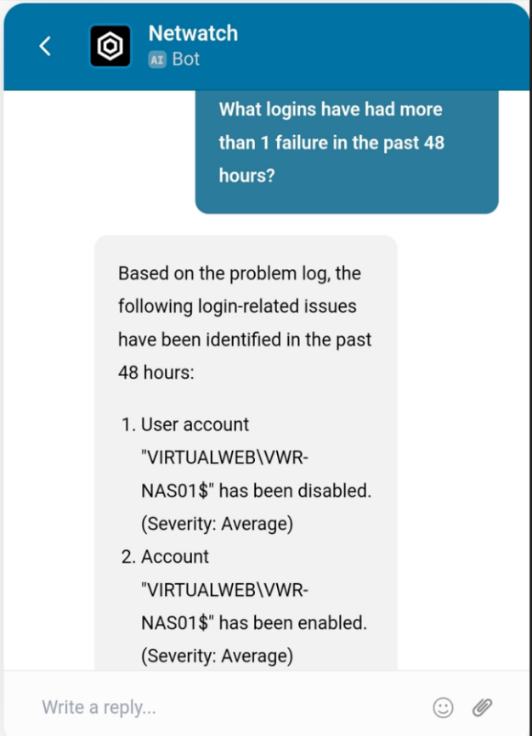
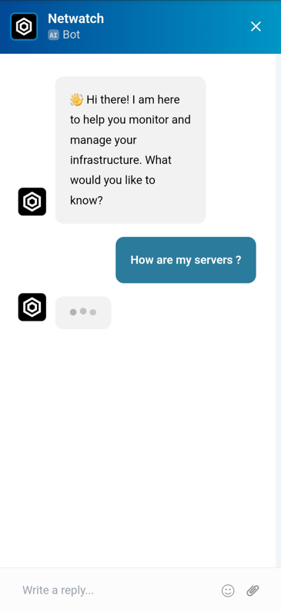
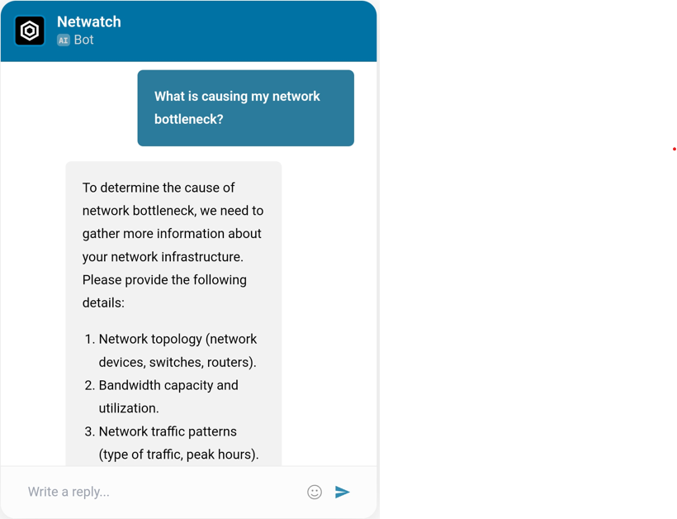
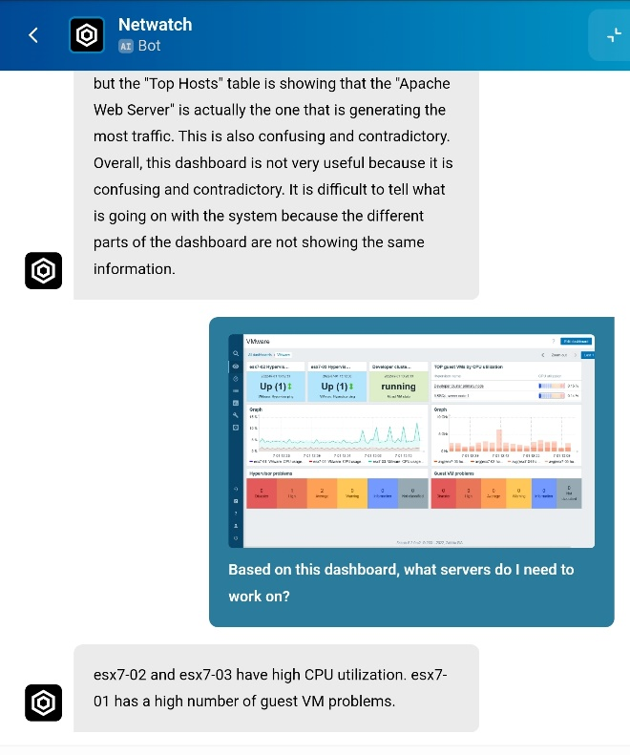
Ai Powered Answers
Flexible Deployment Options
Scalable, AI capabilities through multiple deployment options, ensuring easy access, minimal infrastructure overhead, and automatic updates for all users.
Adapts to diverse business needs, enabling rapid integration and tailored use cases. Offers flexible integration options, supporting a wide range of business workflows and enabling customized configurations to address industry-specific challenges and use cases

Slide 12





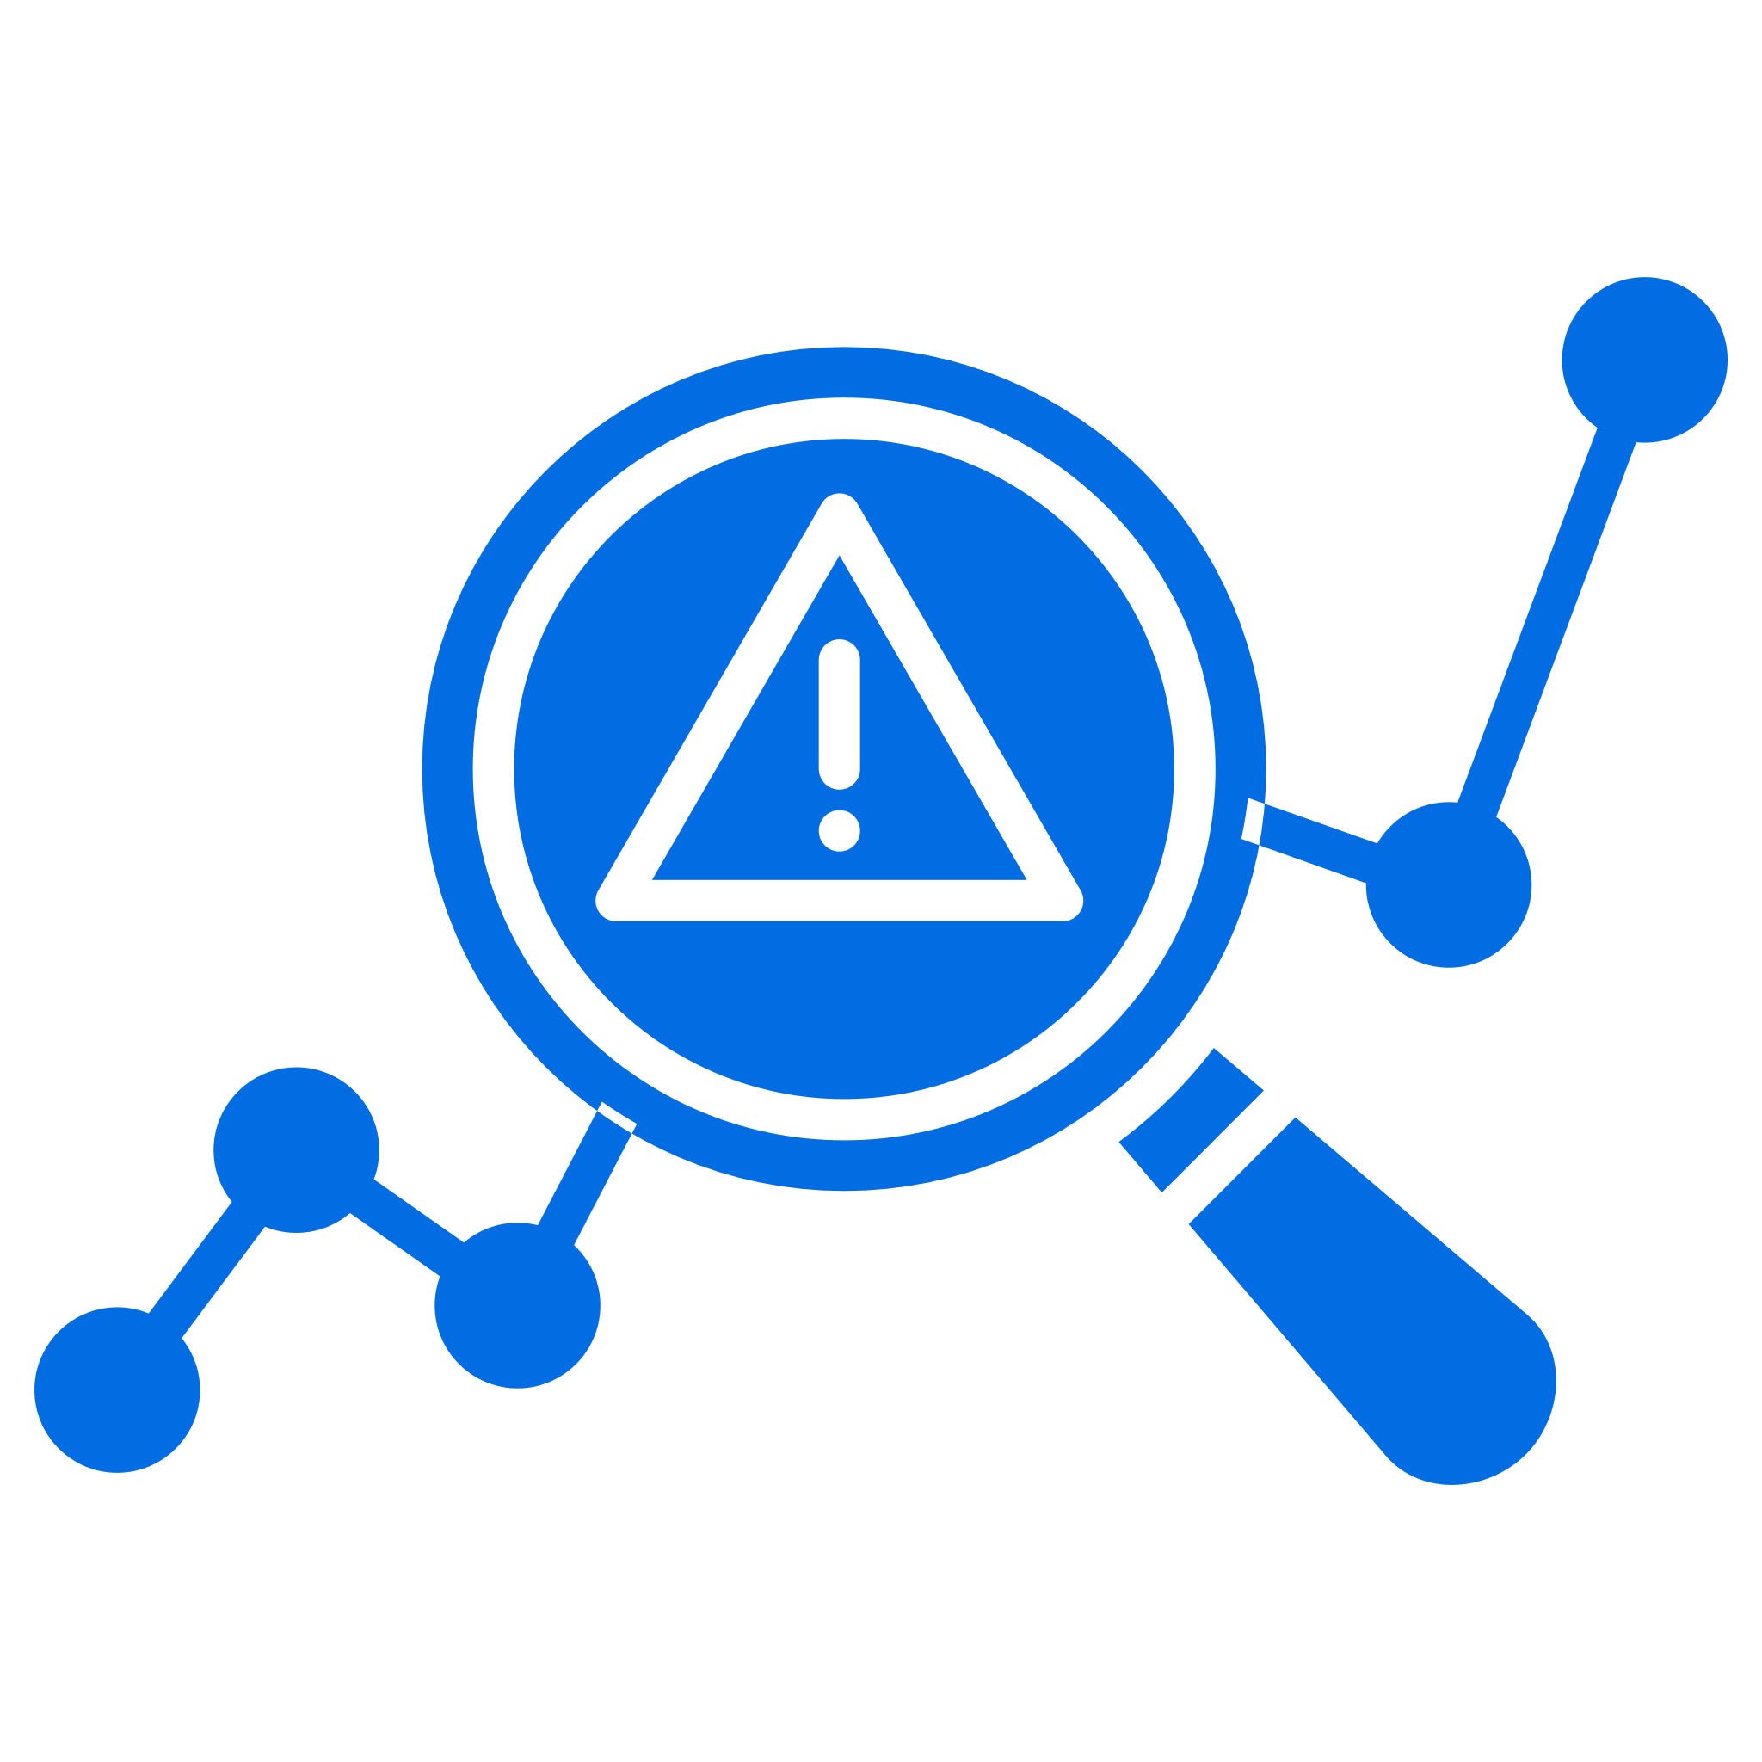
Enhancing Cyber Resilience
Agents, Or Not
NetWatch.Ai provides the choice of using agent or agent-less monitoring with no difference in cost; clients can change from agents to agent-less at any time and can use any combination of agent and agent-less monitoring.
Unification of Relevant Data
NetWatch.Ai is designed to collect, process, and report on all data sources it has access to. It is an intelligent Ai tool that unifies disparate data sources, enables seamless data correlation, and supports robust AI governance with QUARK. Notifies, alerts, reports, and finds root cause with a quick and easy interface.
Healing Actions
With NetWatch.Ai, clients can correct most day-to-day issues automatically with NetWatch.Ai’s wide array of self-healing actions.
Rule Definitions Centrally Managed
NetWatch.Ai Rules are stored independently of individual servers. A rule change only needs to be done in one place, and the change is made globally so individual server definitions do not need to be altered.
Detection of Non-Events
Most monitoring products are event-driven and are only able to detect errors that generate an event. NetWatch.Ai can detect nonevents, such as a hung server or blue screen, memory leaks, and runaway processes, as well as hung services. NetWatch.Ai’s Healing Actions can correct all
these issues.
AI Anomaly Detection
NetWatch.Ai can identify unusual patterns or anomalies in system behavior, which may indicate a problem or security threat, even if it’s not yet apparent to the human operators.

Slide 13
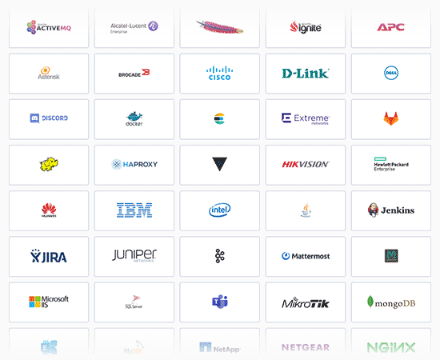
True Single
Pane of Glass
NetWatch.Ai allows you to utilize itself or existing monitoring solutions as well as use NetWatch.Ai Api's in harmony with our ai bot.
This allows for a true single pane of glass top-down view of your environment. Laptops, Servers, Network Devices, iOT Devices, and Cloud Services all on one dashboard…. finally.

Slide 14


WOULD YOU LIKE A PROOF OF VALUE?
Sales@NetWatch.Ai
NetWatch.Ai

