Slide 1

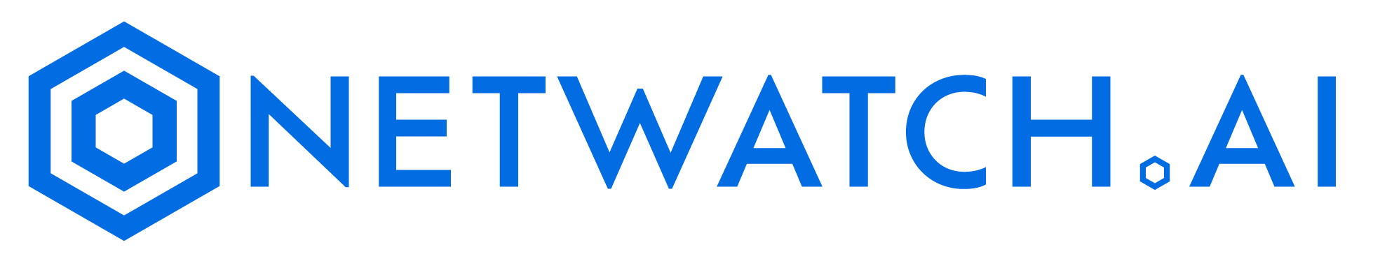
Seamless Monitoring With the Power of Ai

Slide 2


What is NETWATCH.AI
NetWatch.Ai is the world’s most scalable monitoring solution suite for all servers, network devices, and iOT endpoints with flexible artificial intelligent insights.
NetWatch.Ai monitors the health and performance of servers and when issues arise, alerts are executed via NetWatch.ai dashboard. Our AI interface allows for help desk empowerment and increases speed to diagnose complex networks to prevent server outages.
Using a patented technology NetWatch.Ai monitors devices with or without installing agents, providing the power and flexibility to define the monitoring architecture to match customers’ exact needs.

Slide 3

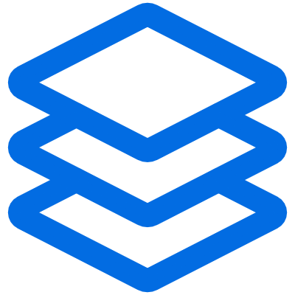
Product Offerings
NetWatch OPS
Secure OPS
Ai
Core Products
Comprehensive server monitoring solution ensuring real-time insights, proactive alerts, and seamless resource management for optimized IT infrastructure performance.
A hybrid SIEM platform that seamlessly integrates cloud & on-premise environments, delivering unified security monitoring and compliance management.
Ai driven monitoring platform leveraging machine learning to predict issues, automate solutions, and enhance IT operations for smarter performance management.
Core Services
HiveOps SOC
Customizable security operations center offering multi-layered threat detection, response, and mitigation tailored to meet diverse organizational security requirements effectively. Currently only offered to NetWatch customers.

Slide 4


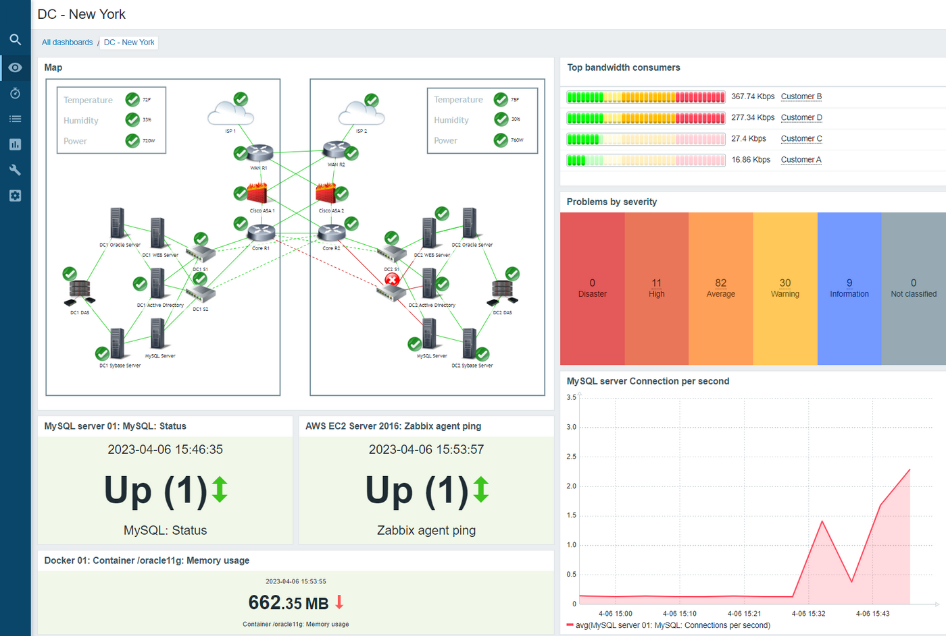
NetWatch OPS
Comprehensive Coverage
Monitor servers, networks, and applications from a single interface, ensuring that no component
goes unnoticed.
Instantaneous Performance Metrics
Track CPU usage, memory consumption, disk I/O, network latency, and application response times in real-time.
Dynamic Thresholds
Set customizable thresholds for alerts based on historical performance data and predictive analytics.
Multi-Channel Alerts
Receive alerts via email, SMS, or through integrations with collaboration tools like Slack or Microsoft Teams.
Severity-Based Notifications
Categorize alerts by severity (Critical, Warning, Information) to prioritize and response and efforts effectively.
Incident Escalation Policies
Implement automatic escalation procedures to ensure critical issues receive timely attention from relevant stakeholders.
User-Friendly Interface
Customize your dashboards to showcase the most relevant data for your organization, offering a visual, intuitive experience.
Drag-and-Drop Functionality
Easily add or rearrange widgets to tailor dashboards to specific operational needs.

Slide 5

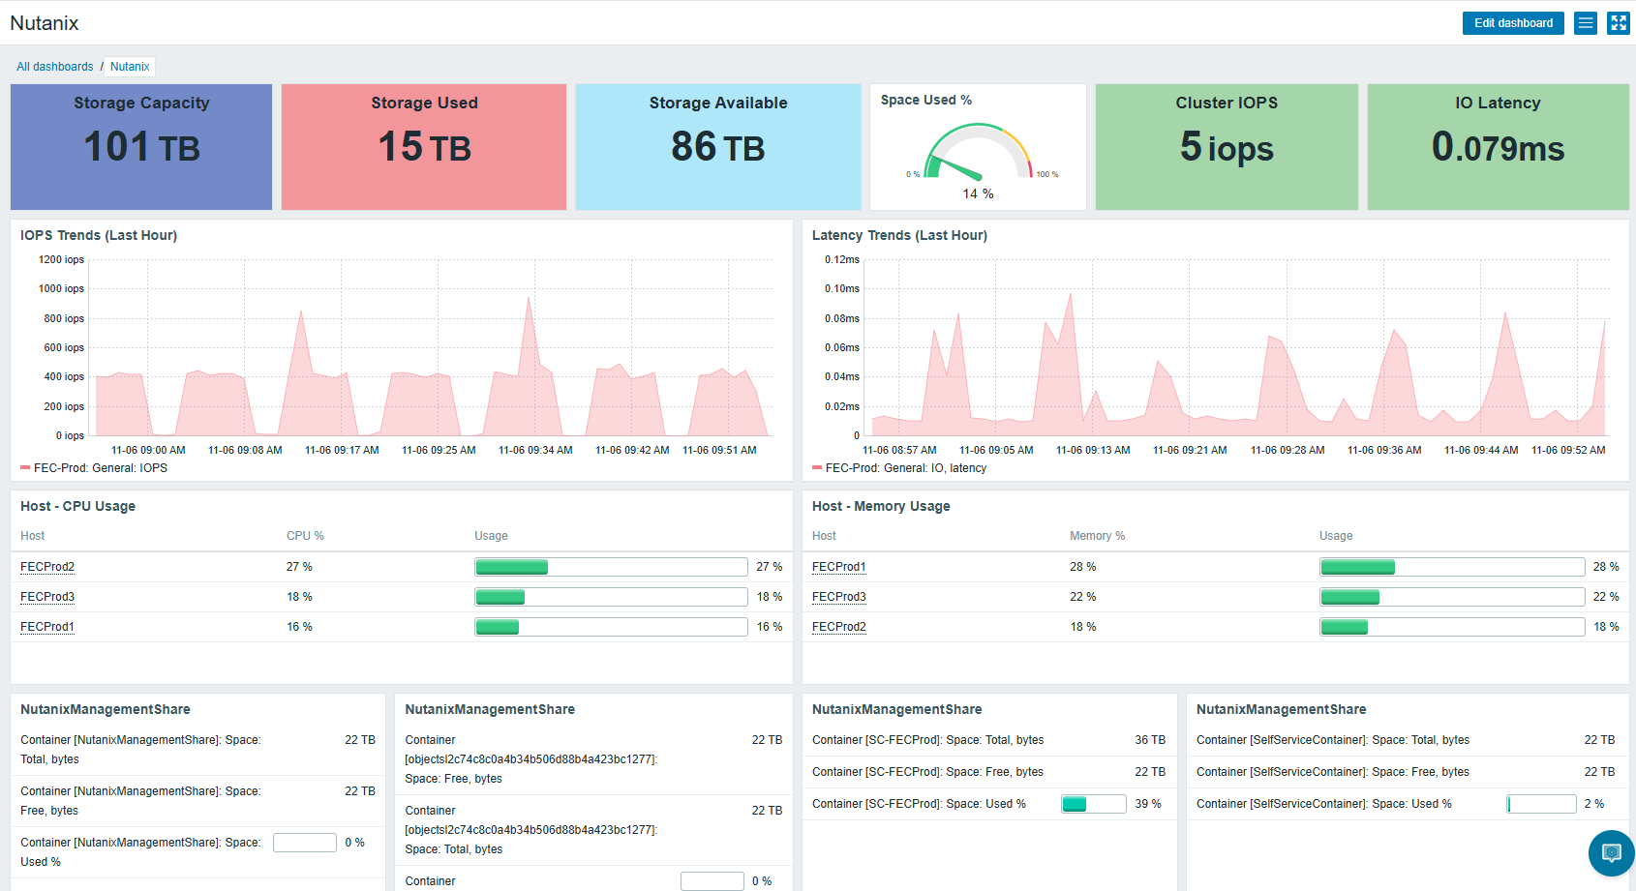
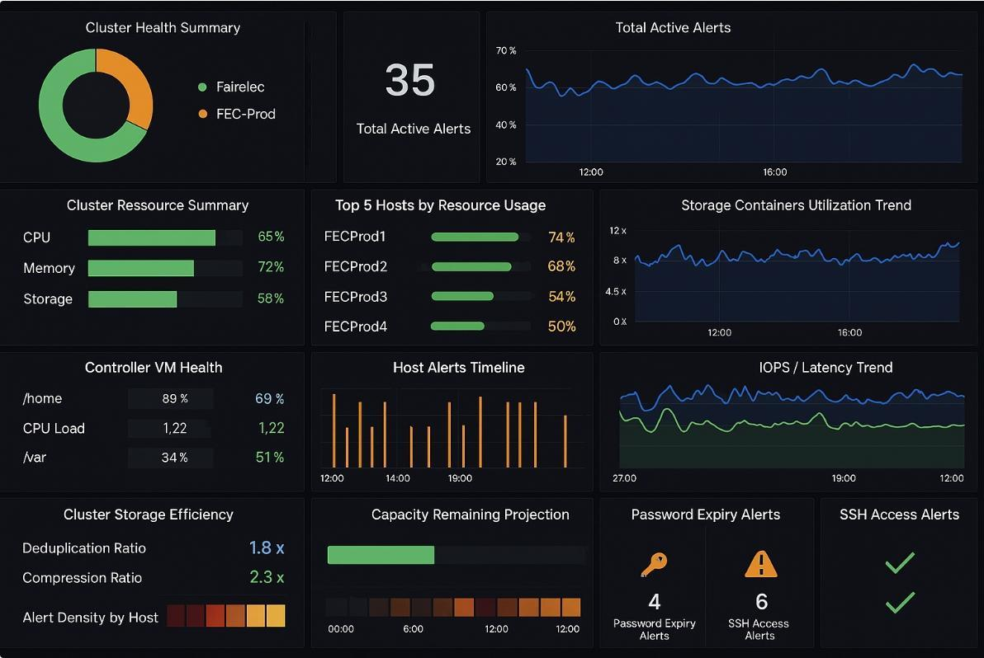
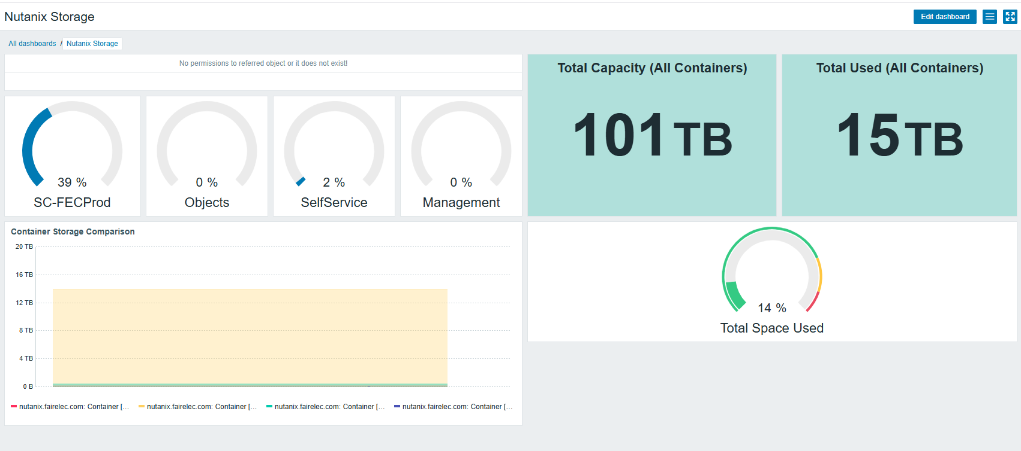
Nutanix
Detailed Management Dashboards
NetWatch OPS allows for the integration of Nutanix API data in management dashboards.
The layout is customized by our team based on your requirements for latency, space utilization and compliance & risk.
Since all data is captured and stored in Netwatch OPS backend, you can build reports for it or simply ask the Ai about utilization or latency or even about password alerts.
NetWatch.Ai makes management of the Nutanix environment simple and efficient.

Slide 6
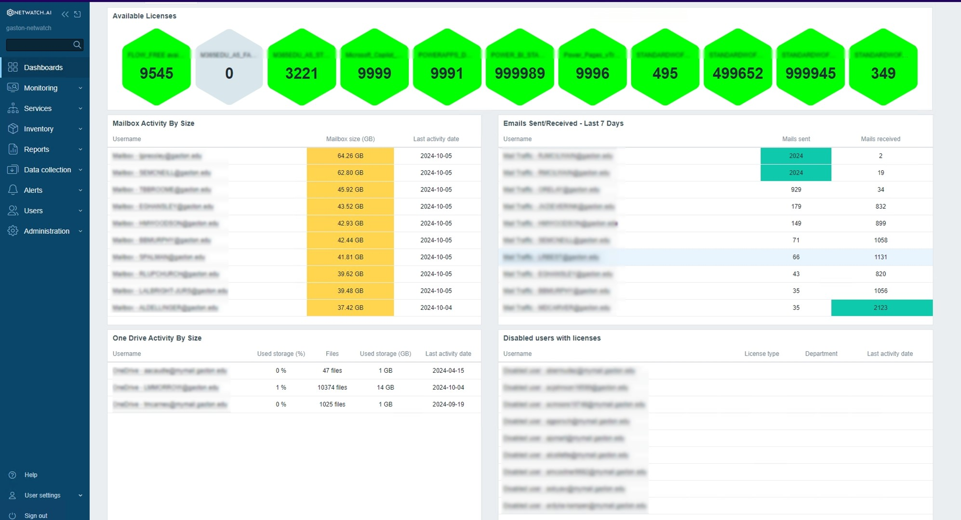
M365
Cloud Key Management Dashboards
NetWatch OPS allows for the optional use of M365 management of keys from a quick dashboard view.
The layout is customized based on your requirements for mailboxes, OneDrive, SharePoint or Teams metrics.
Since all data is captured and stored in Netwatch OPS backend, you can build reports for it or simply ask the Ai what keys aren’t being utilized or have passwords that are about to expire.
NetWatch.Ai makes management of the M365 environment simple and efficient.

Slide 7

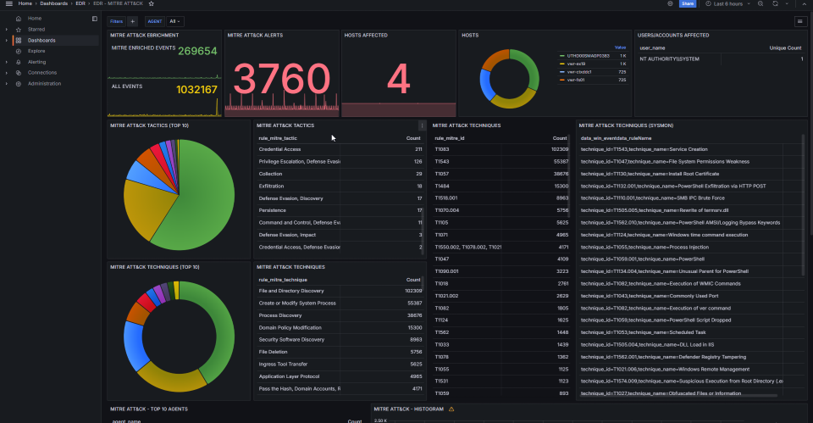

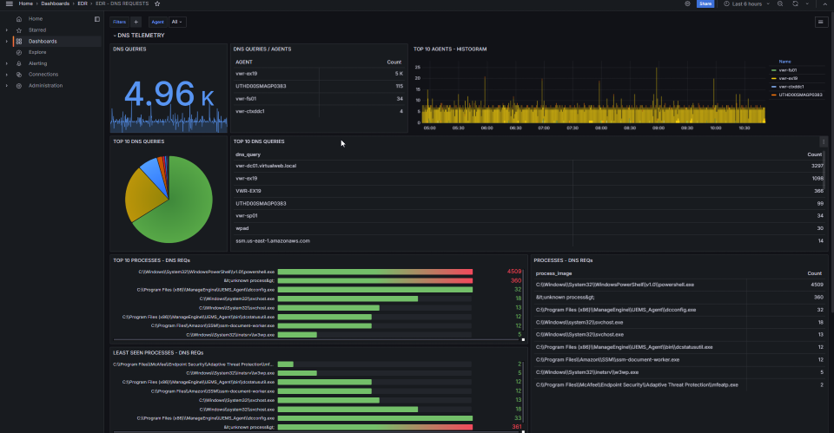
Login
Contact Us
Secure OPS
Next-generation SIEM solution designed to revolutionize your security infrastructure
Cloud & On-Prem together at last
Next-generation SIEM solution designed to revolutionize your security infrastructure. A hybrid SIEM platform that seamlessly integrates cloud & on-premise environments, delivering unified security monitoring and compliance management

Slide 8
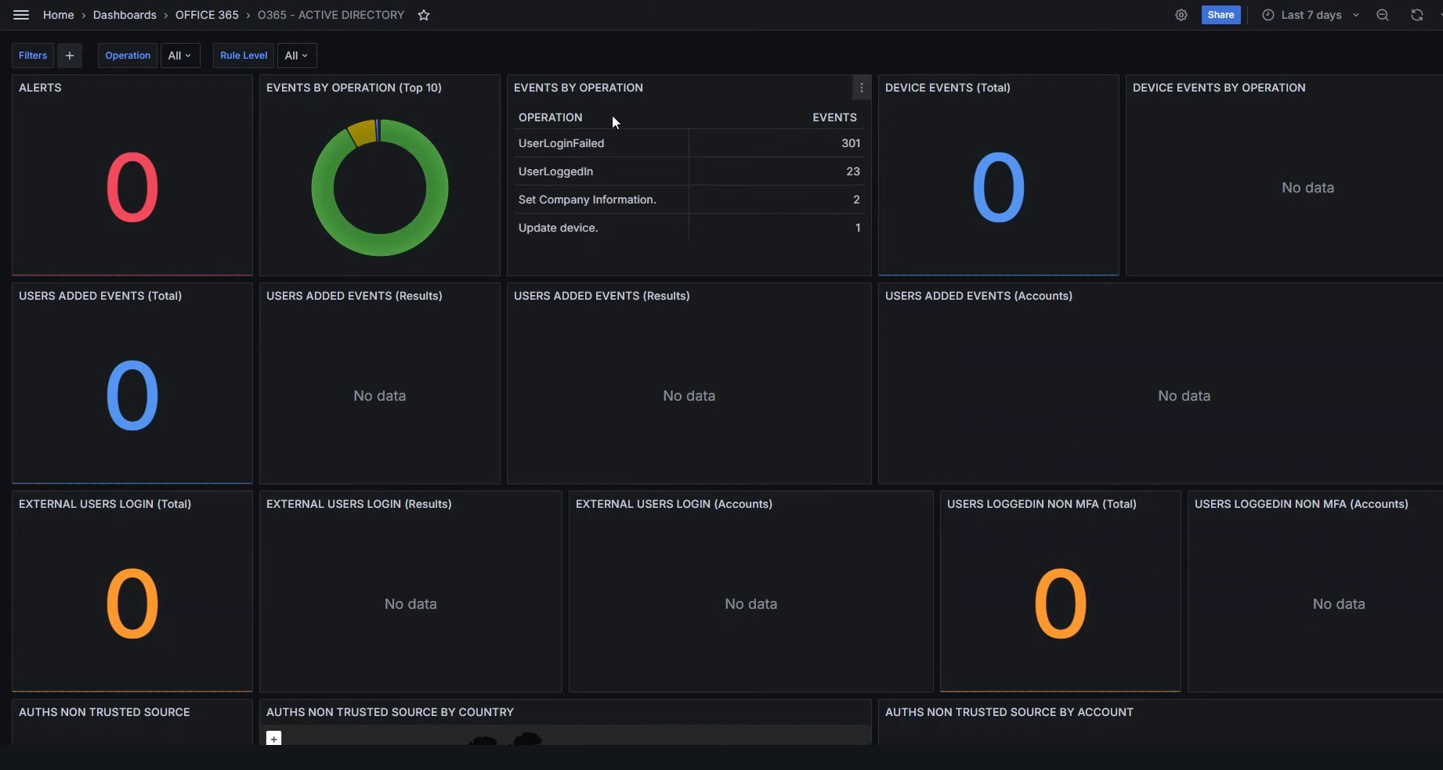

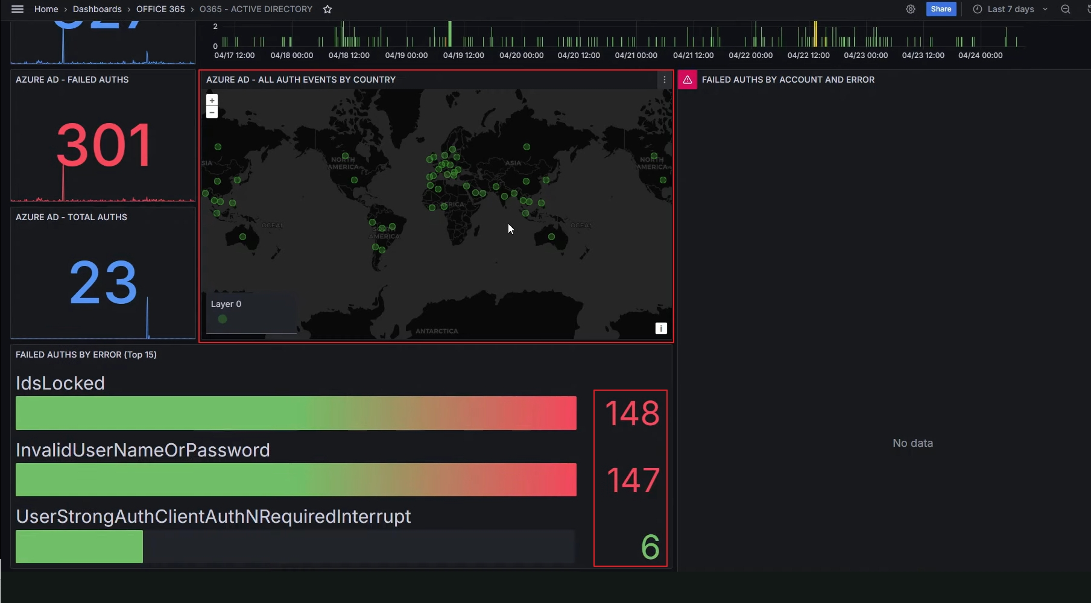
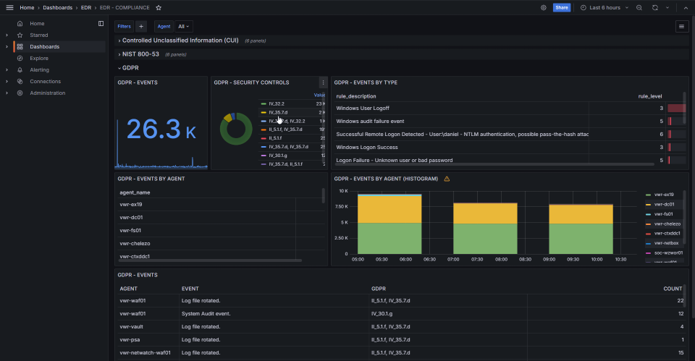
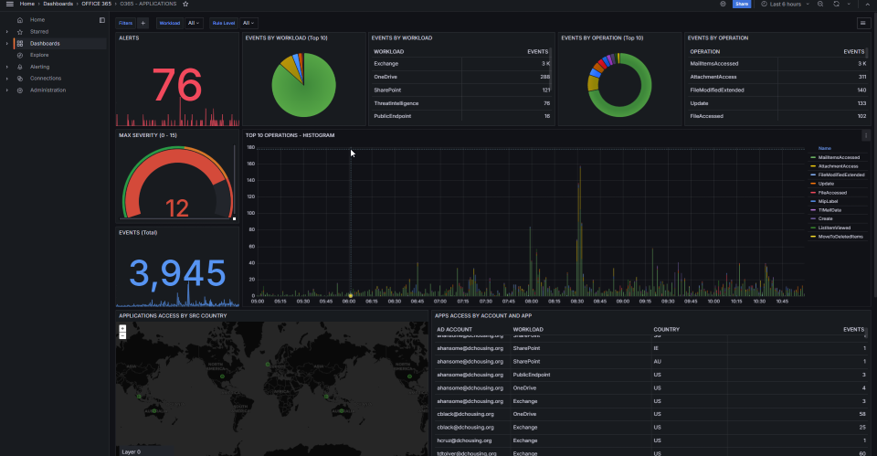
complete SIEM = actionable alerts
Robust support for multiple compliance frameworks, Secure Ops simplifies adherence to industry standards such as GDPR, CIS, NIST, and more. Its advanced CVE update integration ensures your threat intelligence is always current, while built-in MITRE ATT&CK analysis offers in-depth insights into attack patterns and adversary tactics.
As one of the only true hybrid SIEM platforms, Secure Ops seamlessly integrates cloud and on-premise environments, providing comprehensive, unified security monitoring and compliance management.
Empower your security team with real-time alerts, automated threat detection, and streamlined compliance reporting—all within a flexible, scalable platform that adapts to your evolving infrastructure. Secure Ops by Netwatch.ai is your ultimate partner for comprehensive, unified, and future-proof security management toolset.

Slide 9



Ai
Ai driven monitoring platform leveraging machine learning to predict issues, automate solutions, and enhance IT operations for smarter performance management.
Additional personalities include
Product Overview
NetWatch.Ai’s Patented AI System Administrator redefines the role of IT management through advanced artificial intelligence that operates within our secure private cloud.
This innovative tool streamlines system administration by leveraging machine learning to automate routine tasks, optimize operations, and provide deep insights into your IT environment.
As a cornerstone of our technology suite, it enhances the functionality of all our products while offering the flexibility to integrate with third-party applications via API.
CISO personality.
Ai threat Hunting.

Slide 10
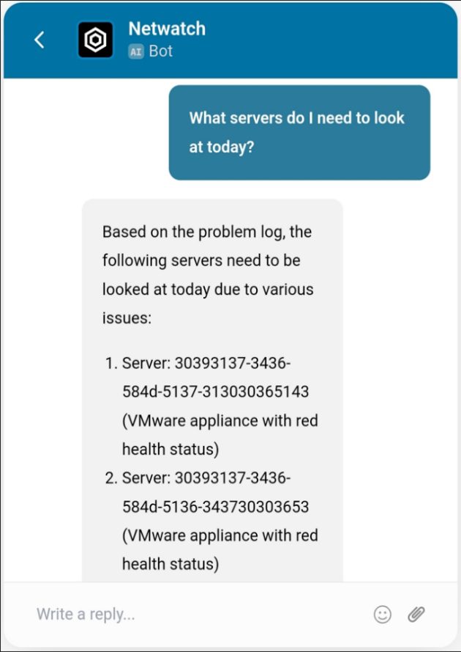
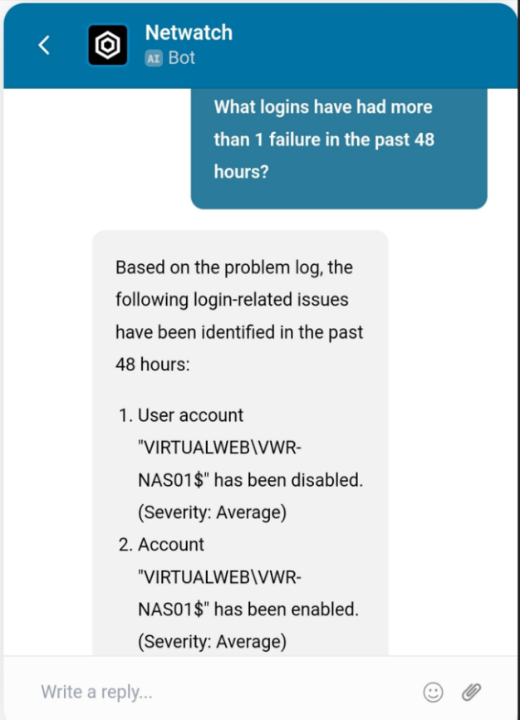
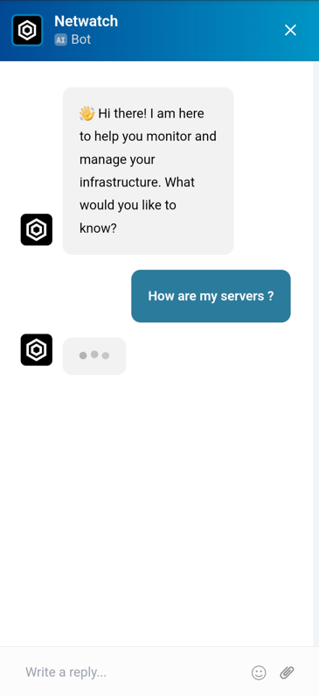
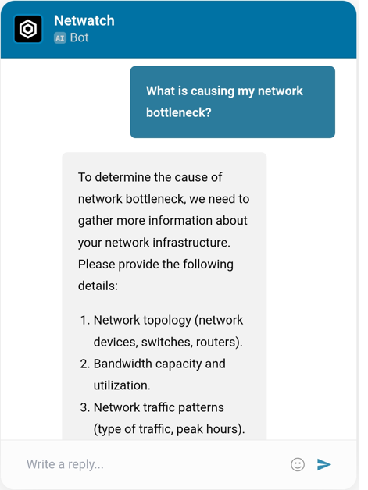
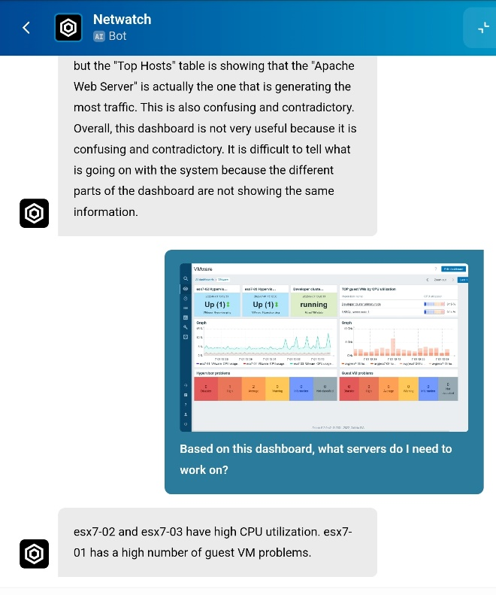
Artificial Intelligent Flexible Application
NetWatch.Ai allows for the optional use of an Ai bot to help your IT group troubleshoot areas of concern or give a tip to point the helpdesk in the right direction. It understands the context of your environment, so you can ask predictive questions about hardware and server issues pertaining to your specific needs..
Ai answers questions on how to configure alerts and rules within NetWatch products and any connected 3rd party product. The Ai tool is optional and can be loaded as a standalone app without the need for a dashboard.
The Ai can read screenshots for the IT resource and give them pointers on what to work on.

Slide 11
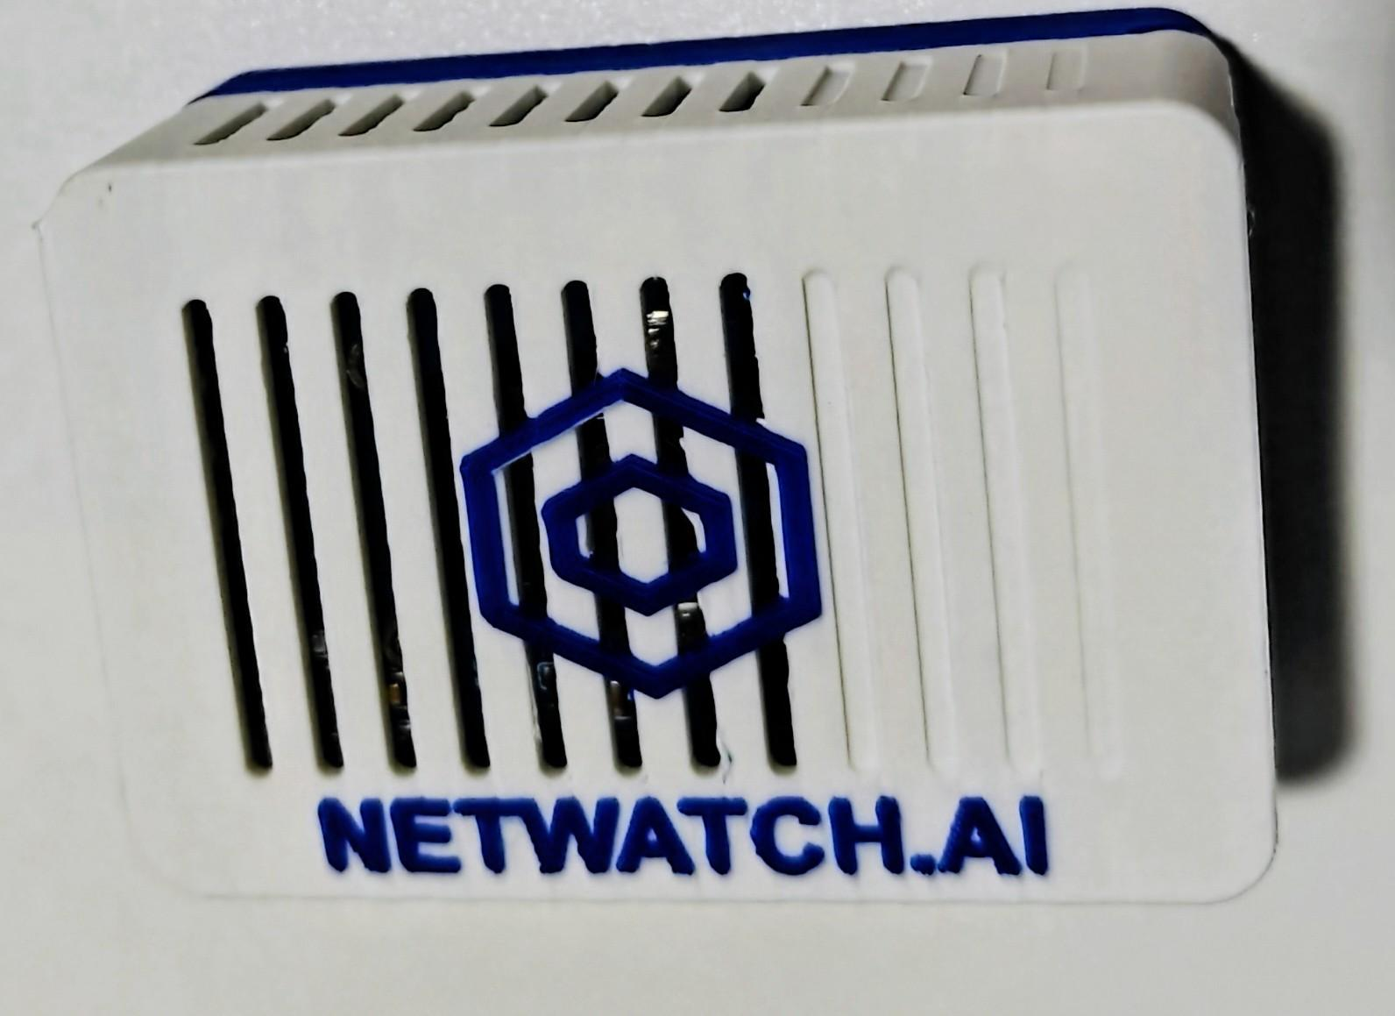
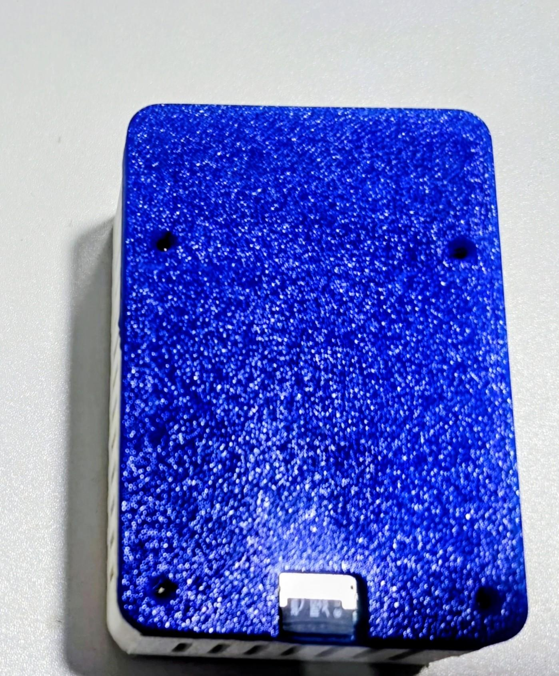
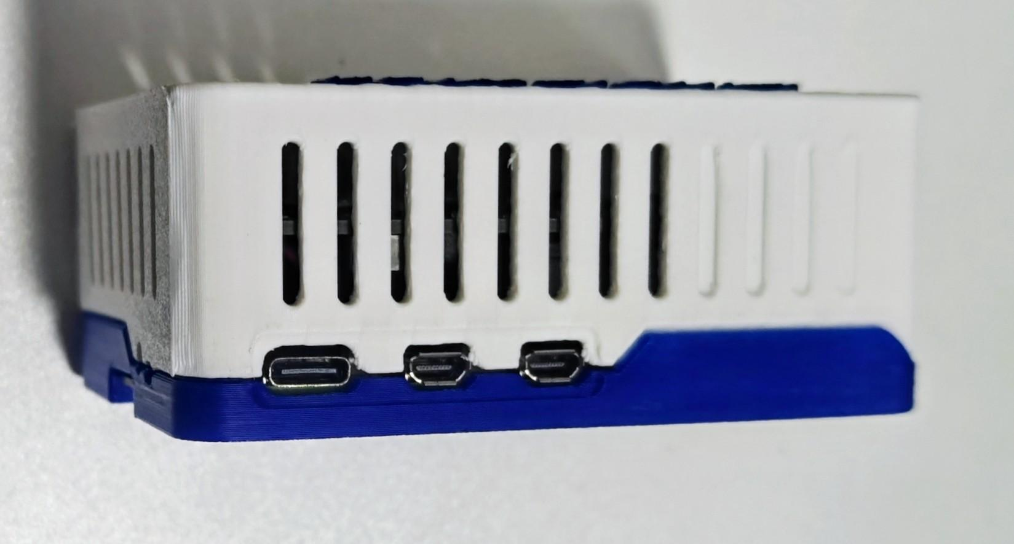
Deployment Options
Ai driven monitoring platform with flexibility to deploy as an virtual Image, SaaS, Hybrid or with our MicroNode™ depending on your own network layout and needs.
Deployment Overview
Virtual Image -Ubuntu
SaaS – our private cloud
Hybrid deployment
On-prem
MicroNode™

Slide 12





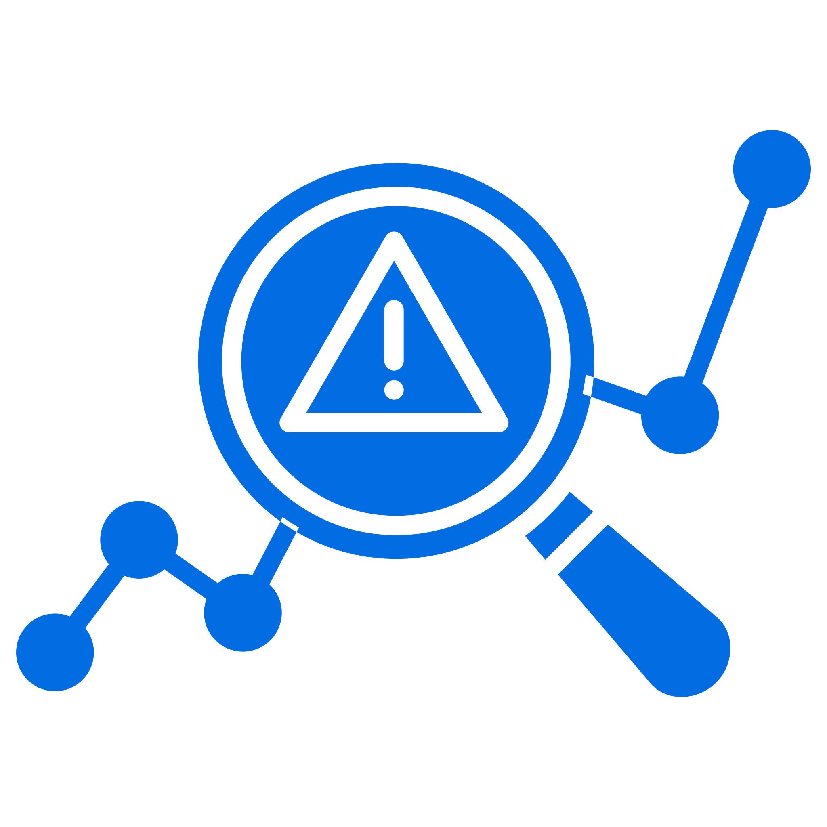
Enhancing Cyber Resilience
Agents, Or Not
NetWatch.Ai provides the choice of using agent or agent-less monitoring with no difference in cost; clients can change from agents to agent-less at any time and can use any combination of agent and agent-less monitoring.
Cloud Aggregation Data
NetWatch.Ai is designed to collect, process, and report on cloud-based data from multiple sources, providing a unified view of an organization‘s cloud infrastructure. This enables organizations to gain insights into their cloud usage, costs, and performance, enabling informed decision-making and optimization.
Healing Actions
With NetWatch.Ai, clients can correct most day-to-day issues automatically with NetWatch.Ai’s wide array of self-healing actions.
Rule Definitions Centrally Managed
NetWatch.Ai Rules are stored independently of individual servers. A rule change only needs to be done in one place, and the change is made globally so individual server definitions do not need to be altered.
Detection of Non-Events
Most monitoring products are event-driven and are only able to detect errors that generate an event. NetWatch.Ai can detect nonevents, such as a hung server or blue screen, memory leaks, and runaway processes, as well as hung services. NetWatch.Ai’s Healing Actions can correct all
these issues.
AI Anomaly Detection
NetWatch.Ai can identify unusual patterns or anomalies in system behavior, which may indicate a problem or security threat, even if it’s not yet apparent to the human operators.

Slide 13












Legacy Comparisons
Feature / Aspect | NetWatch.Ai | SolarWinds / PRTG (Legacy)
Cloud API Integration | Yes, fully cloud-native APIs for Azure, M365, GCP, VMWare Cloud, AWS | Limited or no cloud-native APIs; primarily on-premises or legacy integrations
Webhooks Support | Yes, supports real-time webhooks for event-driven automation | Limited or no native webhook support
SNMP v3 Support | Yes, fully supports SNMP v3 for secure device monitoring | Yes, supports SNMP v3, but often with limited automation capabilities
AI Integration / Fully Integratable AI | Yes, includes AI-driven insights, anomaly detection, and automation | Limited or no AI capabilities; primarily rule-based monitoring
Platform Architecture | Cloud-native, scalable, and modern architecture. (Hybrid & on-prem also) | Legacy, often on-premises or hybrid with limited cloud integration
Compatibility with Cyber Tools & Ticketing Systems | Seamless integration with various cybersecurity tools and ticketing APIs | Integration possible but often complex, limited to traditional connectors
Data Collection Methodology | Real-time, cloud-based API data collection | Legacy style polling, SNMP, WMI; less real-time and scalable
Support for Multi-Cloud Environments | Native support for Azure, AWS, GCP, VMWare Cloud, and more | Limited or no native support; requires custom configurations
Security & Compliance | Modern security standards, cloud security, and compliance features | Varies; often relies on outdated security models
Communication / Notifications options | Teams, Teams workflow, Telegram, Discord, Outlook, SMS, Signal, WhatsApp, Jira,+ anything with a webhook | SMS, Outlook, some Teams capability but limited scalability
Automation & Orchestration | Built-in automation, event-driven responses, and AI-powered actions | Basic scripting; limited to manual or scheduled tasks
Workflow automation with SUS and performance metrics | Supports Citrix, Teams, M365 for user performance latency and SIEM data | Some manual functionality with log downloading and basic alerts

Slide 14
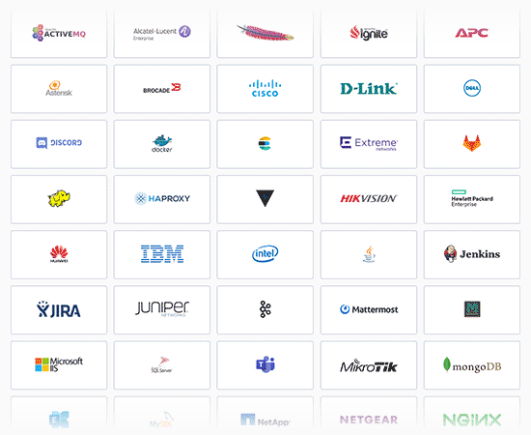
True Single
Pane of Glass
NetWatch.Ai allows you to utilize itself or existing monitoring solutions as well as use NetWatch.Ai Api's in harmony with our ai bot.
This allows for a true single pane of glass top-down view of your environment. Laptops, Servers, Network Devices, iOT Devices, and Cloud Services all on one dashboard…. finally.

Slide 15


WOULD YOU LIKE A PROOF OF VALUE?
Sales@NetWatch.Ai
NetWatch.Ai

