Slide 1
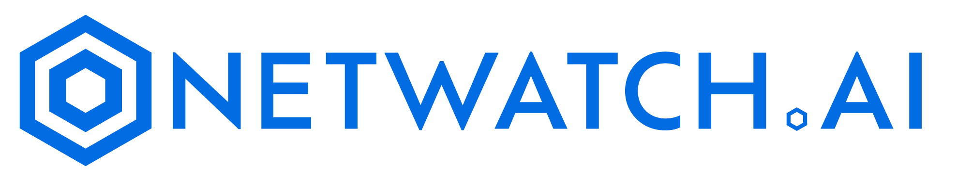
CYBER DEFENSE WITH AI FLEXIBILITY

Slide 2
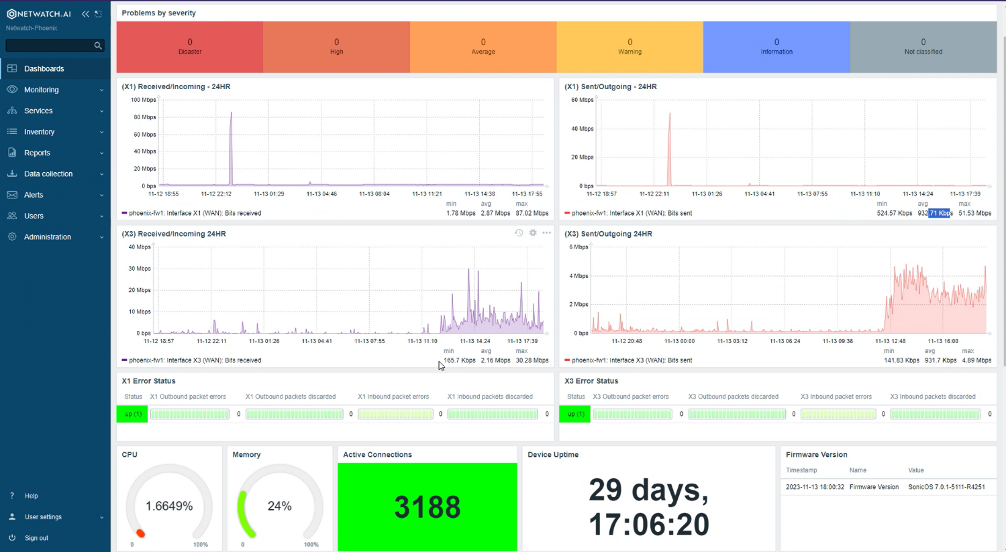
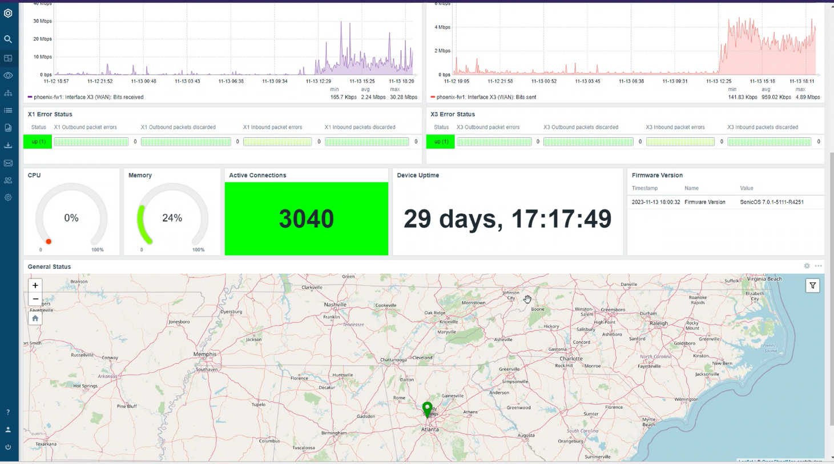
What is NetWatch.ai
NetWatch.ai is the world’s most scalable monitoring solution for all servers, network devices, and iOT endpoints with flexible artificial intelligent insights.
NetWatch.ai monitors the health and performance of servers and when issues arise, alerts are executed via NetWatch.ai dashboard. Our AI interface allows for help desk empowerment and increases speed to diagnose complex networks to prevent server outages.
Using a patented technology NetWatch.ai monitors devices with or without installing agents, providing the power and flexibility to define the monitoring architecture to match customers’ exact needs.

Slide 3
Enhancing Cyber Resilience
Agents, Or Not
NetWatch provides the choice of using agent or agent-less monitoring with no difference in cost; clients can change from agents to agent-less at any time and can use any combination of agent and agent-less monitoring.
Healing Actions
With NetWatch, clients can correct most day-to-day issues automatically with NetWatch’s wide array of self-healing actions.
Detection of Non-Events
Most monitoring products are event-driven and are only able to detect errors that generate an event. NetWatch can detect nonevents, such as a hung server or blue screen, memory leaks, and runaway processes, as well as hung services. NetWatch’s Healing Actions can correct all these issues.
Cloud Aggregation Data
NetWatch is designed to collect, process, and report on cloud-based data from multiple sources, providing a unified view of an organization‘s cloud infrastructure. This enables organizations to gain insights into their cloud usage, costs, and performance, enabling informed decision-making and optimization.
Rule Definitions Centrally Managed
NetWatch Rules are stored independently of individual servers. A rule change only needs to be done in one place, and the change is made globally so individual server definitions do not need to be altered.
AI Anomaly Detection
NetWatch can identify unusual patterns or anomalies in system behavior, which may indicate a problem or security threat, even if it’s not yet apparent to the human operators.

Slide 4
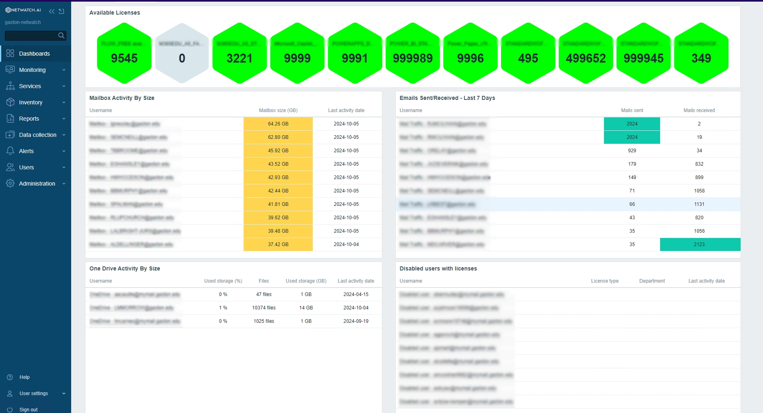
M365 Cloud Key Management Dashboards
NetWatch.ai allows for the optional use of M365 management of keys from a quick dashboard view.
The layout is customized based on your requirements for mailboxes, OneDrive, SharePoint or Teams metrics.
Since all data is captured and stored in Netwatch.ai’s backend, you can build reports for it or simply ask the Ai what keys aren’t being utilized or have passwords that are about to expire.
Netwatch.ai makes management of the M365 environment simple and efficient.

Slide 5
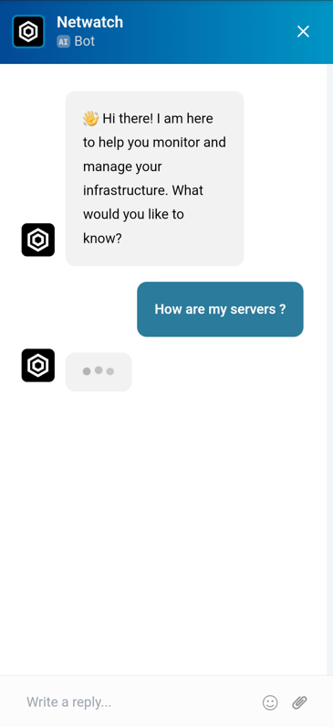
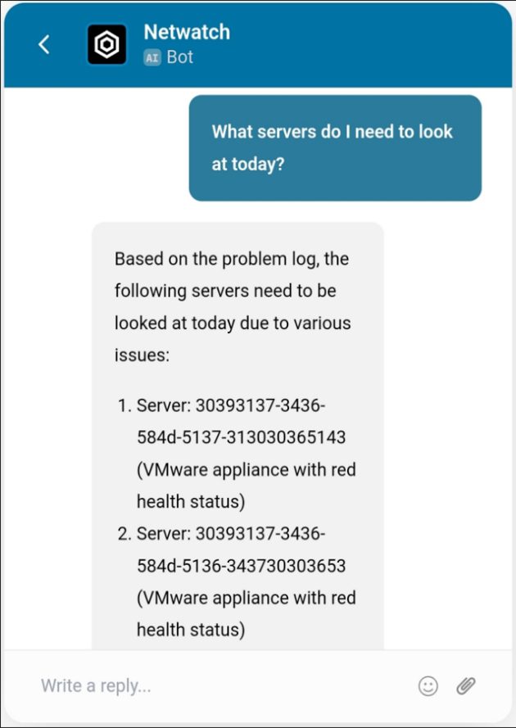
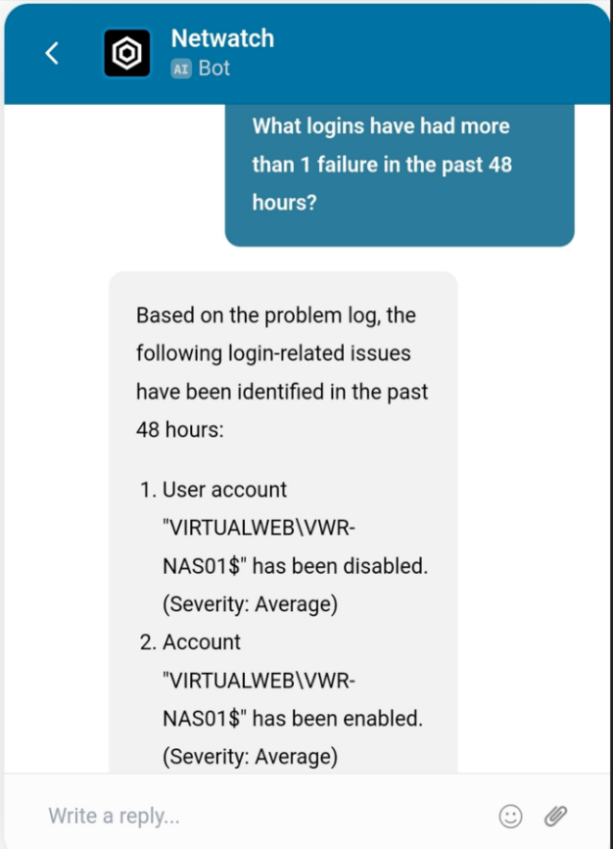
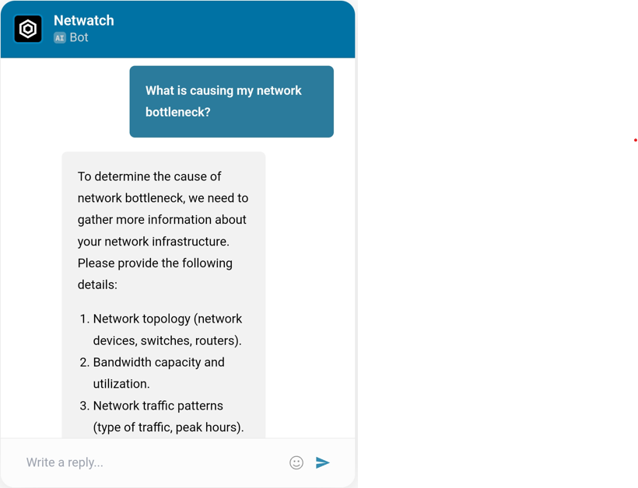
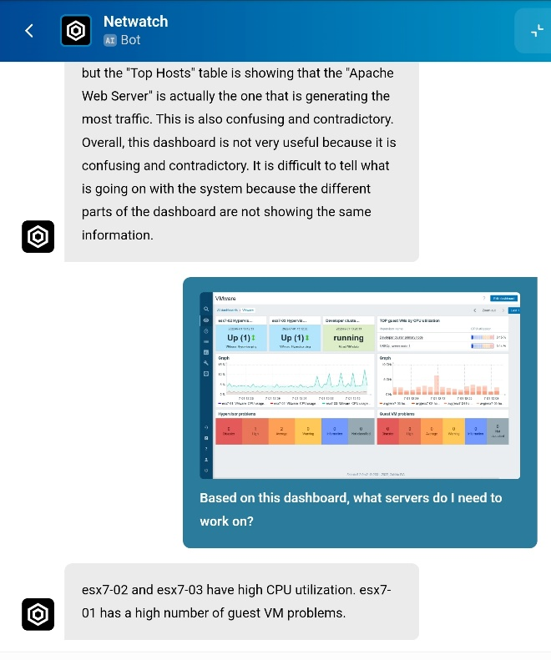
Artificial Intelligent Flexible Application
NetWatch.ai allows for the optional use of an AI bot to help your IT group troubleshoot areas of concern or give a tip to point the helpdesk in the right direction. It understands the context of your environment, so you can ask predictive questions about hardware and server issues pertaining to your specific needs.
The AI can read screenshots for the IT resource and give them pointers on what to work on.
AI answers questions on how to configure alerts and rules within NetWatch. The AI tool is optional and can be loaded as a standalone app without the need for a dashboard.

Slide 6
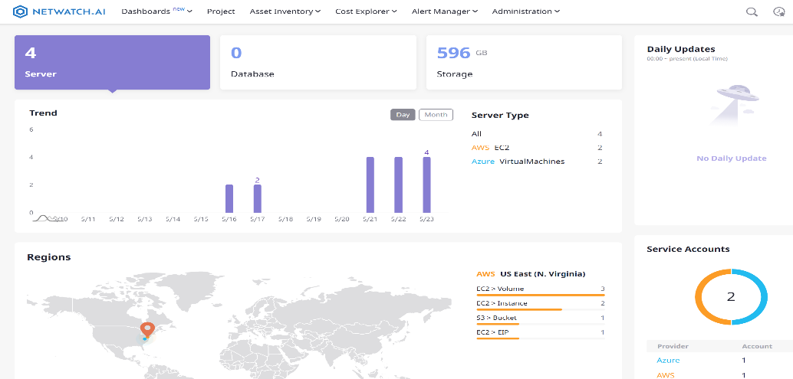
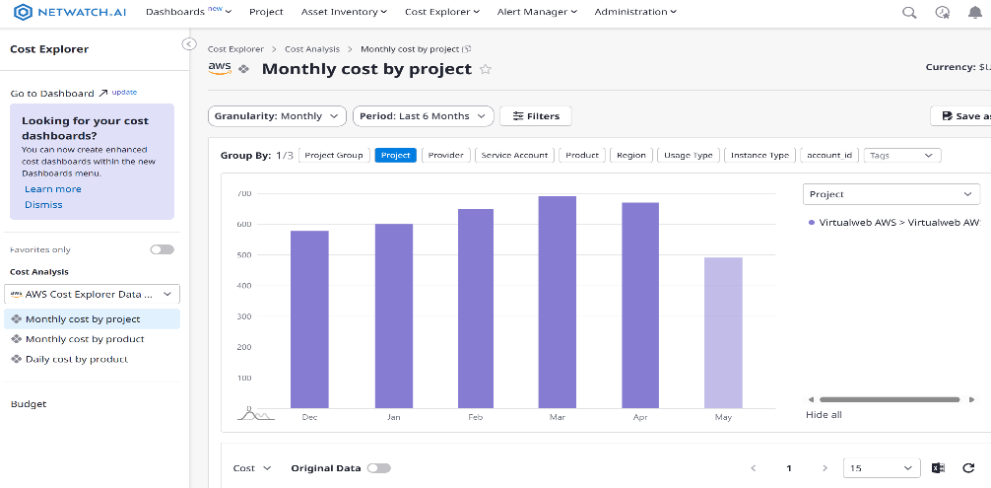
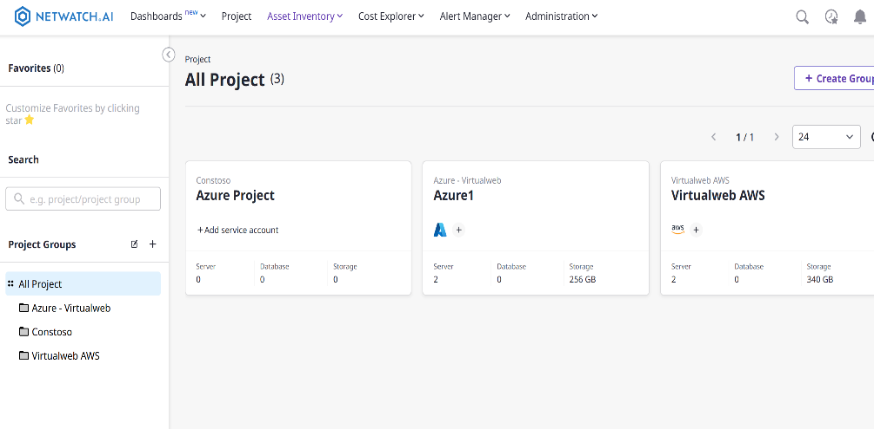
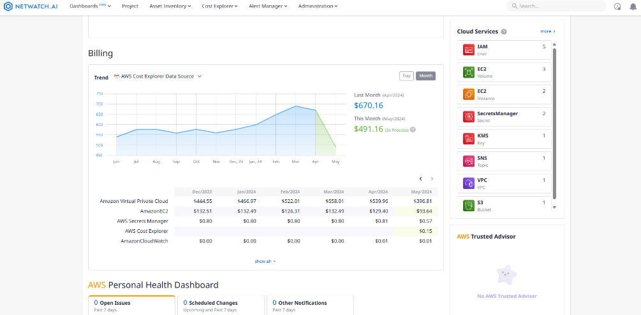
Cloud Aggregation Dashboard
Our cloud management tool is designed to aggregate and analyze data from multiple cloud sources to help manage an organization's cloud infrastructure. By collecting data from various cloud providers, such as AWS, Azure, Google Cloud, and others, NetWatch enables organizations to gain a unified view of their cloud resources, including infrastructure, applications, and costs. This comprehensive visibility allows IT teams to identify trends, patterns, and areas for improvement, making it easier to optimize cloud usage and reduce costs.
With NetWatch, organizations can gain insights into their cloud usage patterns, including which resources are being used the most, which applications are consuming the most resources, and where costs can be optimized. The tool also provides real-time monitoring and alerting capabilities, enabling IT teams to quickly identify and respond to issues before they become critical.

Slide 7

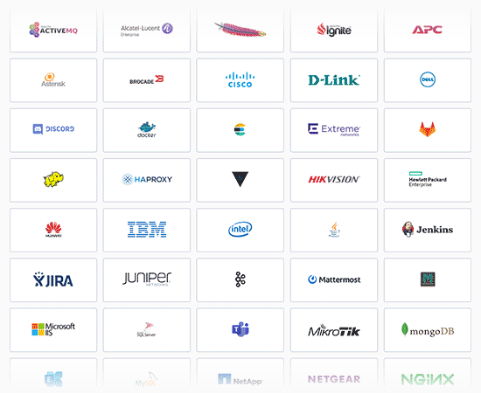
True Single Pane of Glass
NetWatch allows you to utilize itself or existing monitoring solutions as well as use NetWatch Api's in harmony with our ai bot.
This allows for a true single pane of glass top-down view of your environment. Laptops, Servers, Network Devices, iOT Devices, and Cloud Services all on one dashboard…. finally.

Slide 8
Would you like a proof of value?
Sales@NetWatch.ai
Website - NetWatch.Ai

